Slide 1
Your Kids Can Code
How Children and Teens Can
Learn Programming Skills at Any Age
Jeremy Moritz
Software Engineer/Author
Notes:
We’ll have a question and answer period, so if you have a question, please write it down
(PREP: plug in USB connector for clicker. open up scratch new, harmony’s “DO IT”, and Tony’s “Shark Bite”)

Slide 2

Who Am I?
Senior Software Engineer

Slide 3
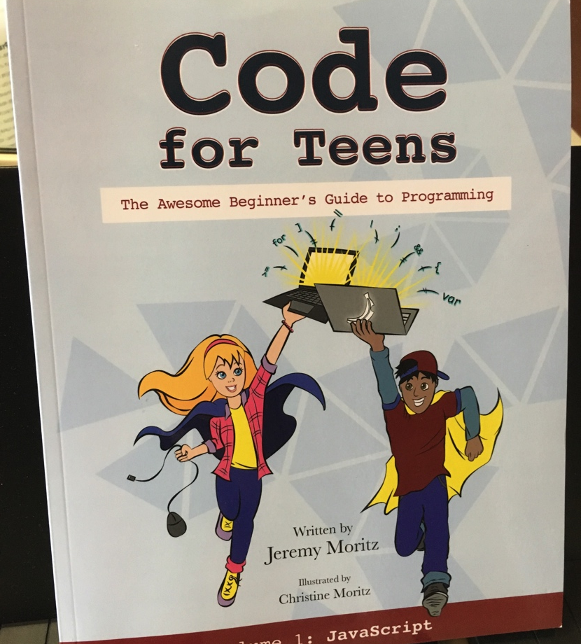
Who Am I?
Senior Software Engineer
Author of Code for Teens: The Awesome Beginner’s Guide to Programming

Slide 4
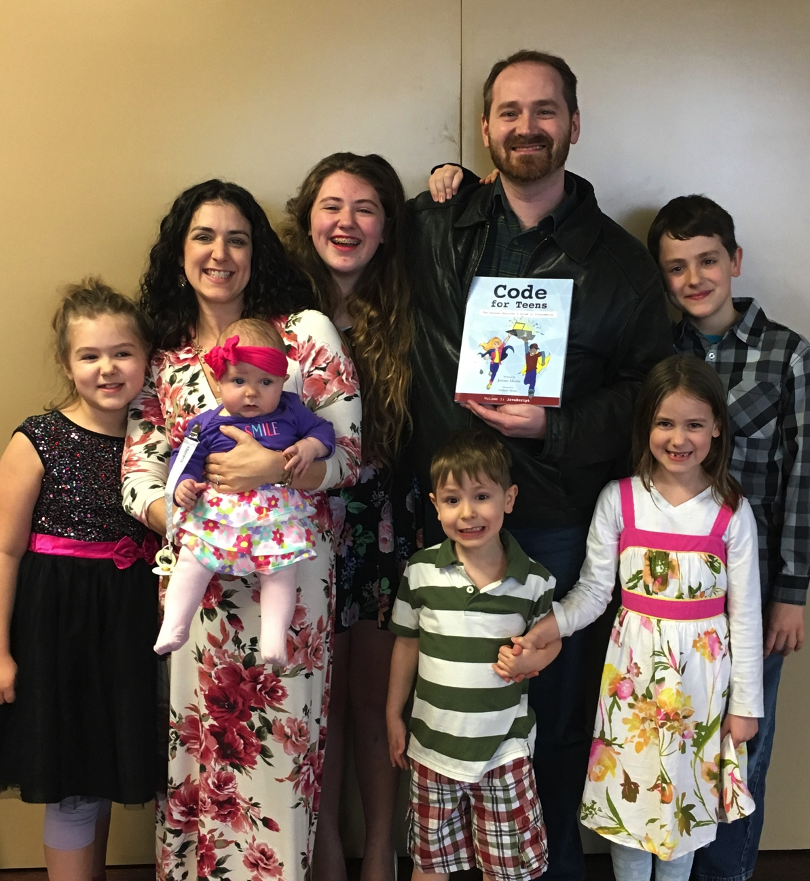
Who Am I?
Senior Software Engineer
Author of Code for Teens: The Awesome Beginner’s Guide to Programming
Homeschooling father of 6 children

Slide 5
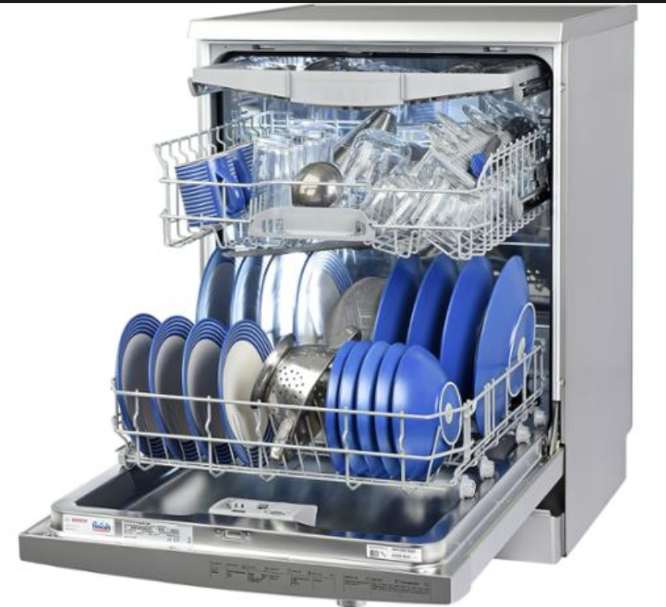
Who Needs a Dishwasher?

Slide 6
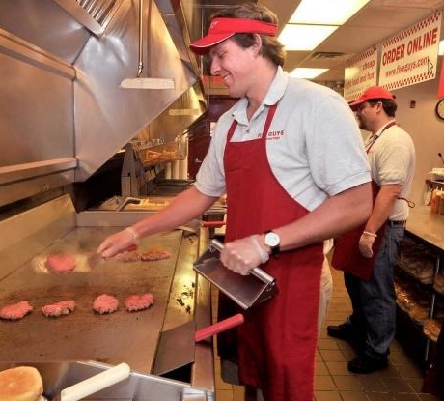
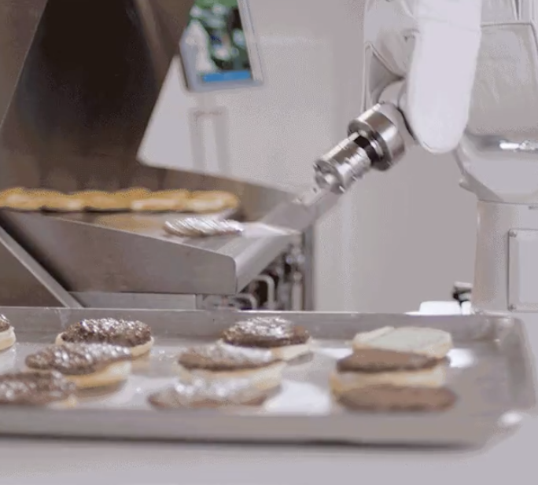
What Comes to Mind?
Burger Flipper

Slide 7
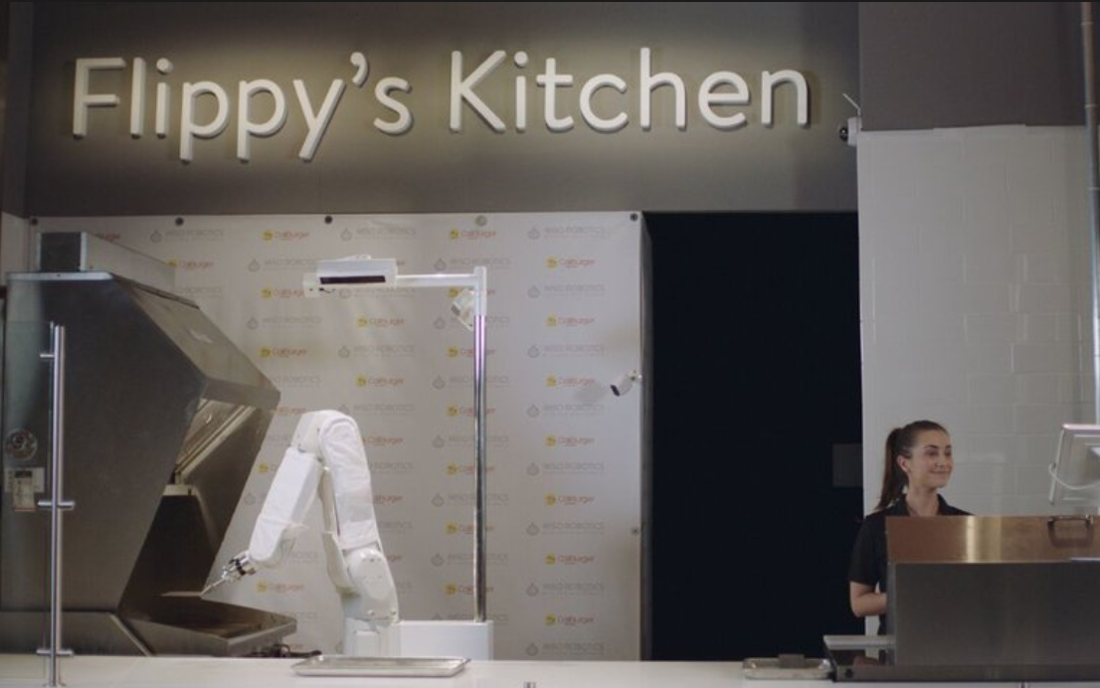

What Comes to Mind?
Burger Flipper

Slide 8
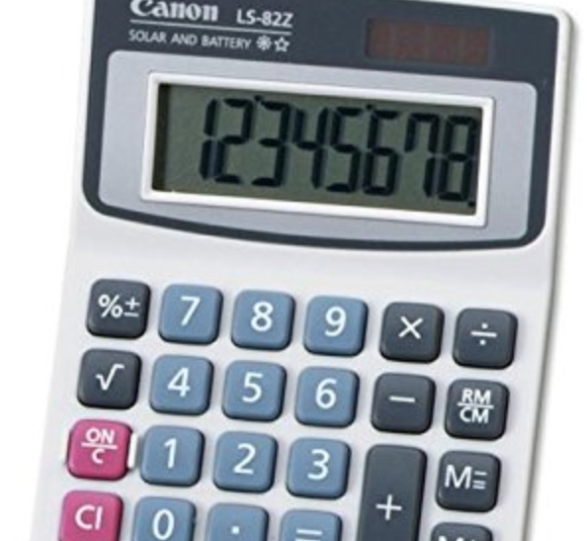
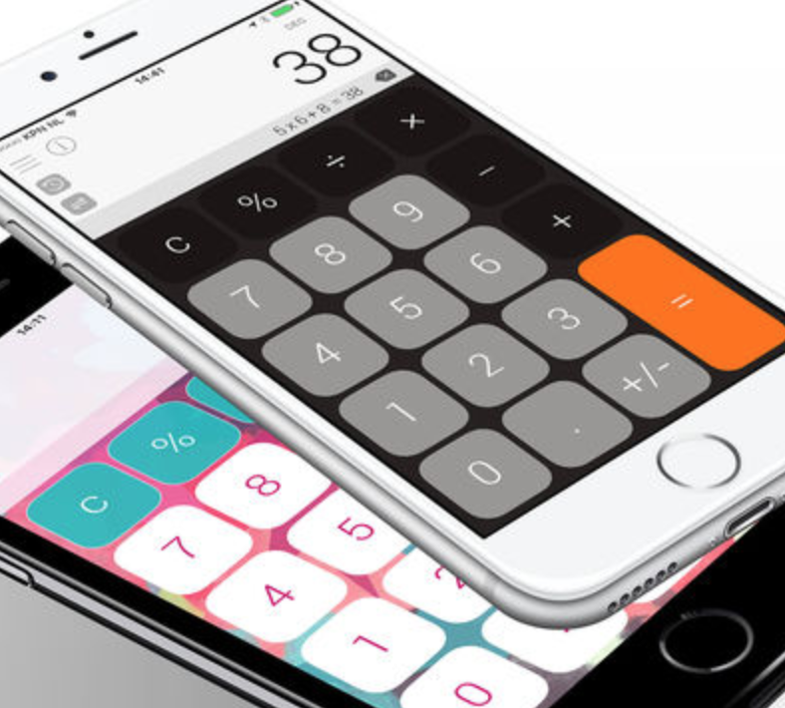
What Comes to Mind?
Calculator

Slide 9
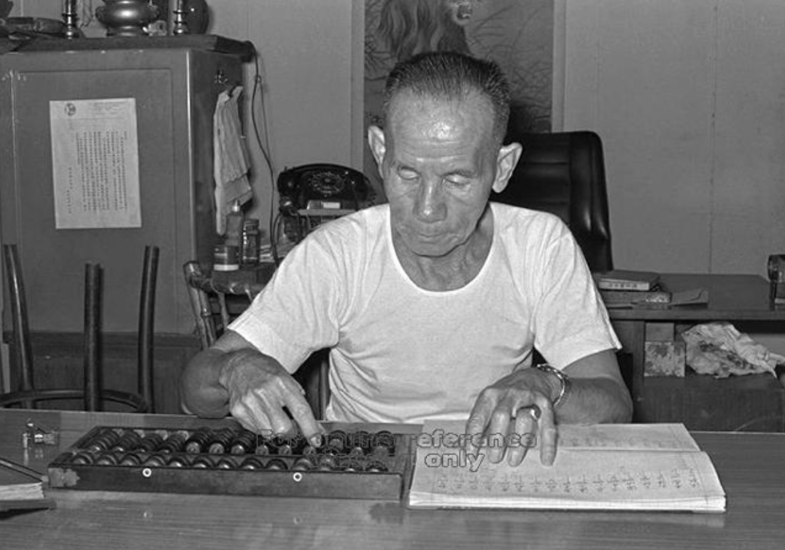
What Comes to Mind?
Calculator

Slide 10
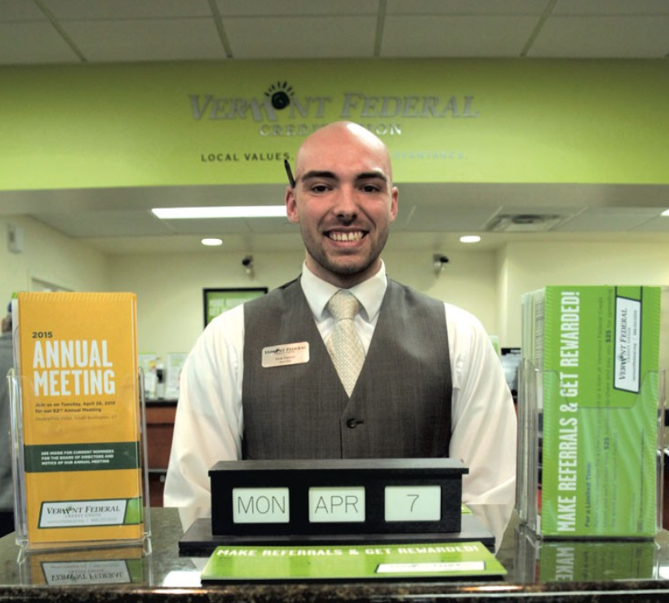
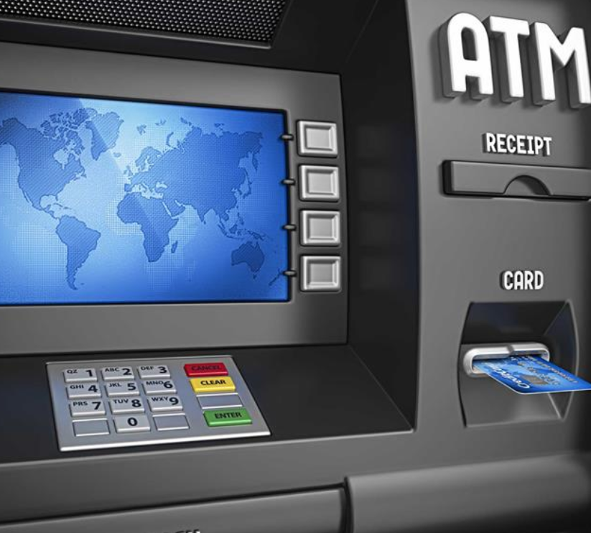
What Comes to Mind?
Bank Teller

Slide 11
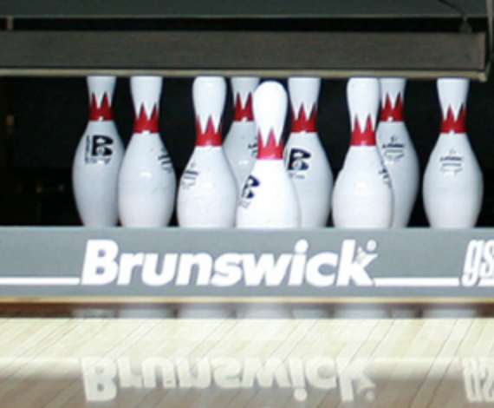
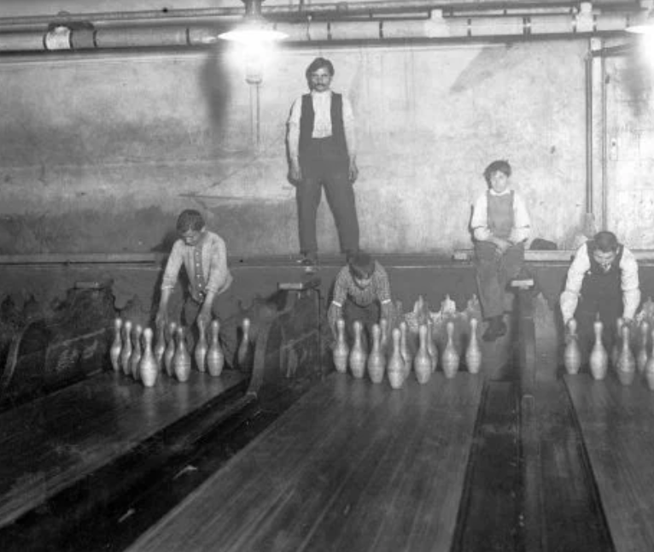
What Comes to Mind?
Bowling Ball Pin Setter

Slide 12

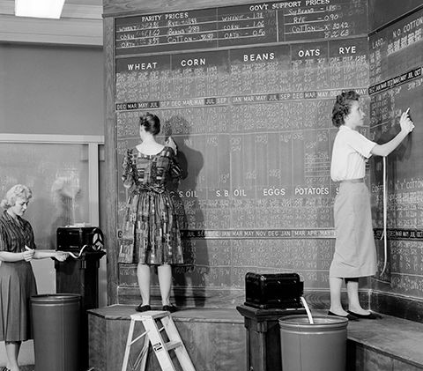
What Comes to Mind?
Computer

Slide 13
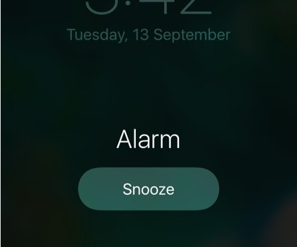
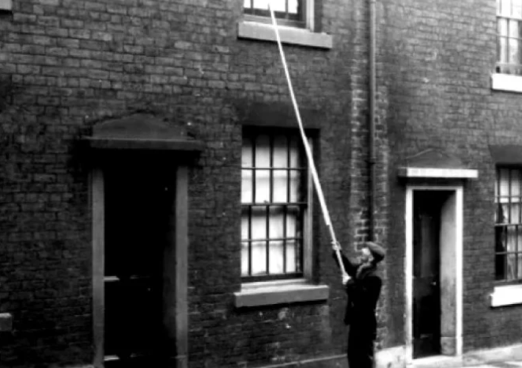
Need an Alarm?
Phone
Knockerupper

Slide 14
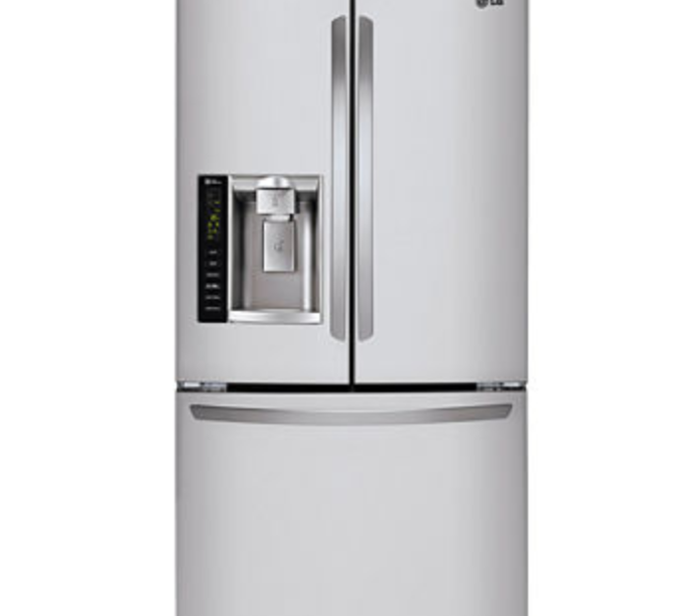
What Comes to Mind?
Refrigerator

Slide 15
What is Happening to Jobs?
Notes:
(NEXT, right away)

Slide 16
What is Happening to Jobs?
Jobs are continually replaced by technology (no surprise)
According to 140 years of census data*, more jobs are created by technology than destroyed.

Slide 17
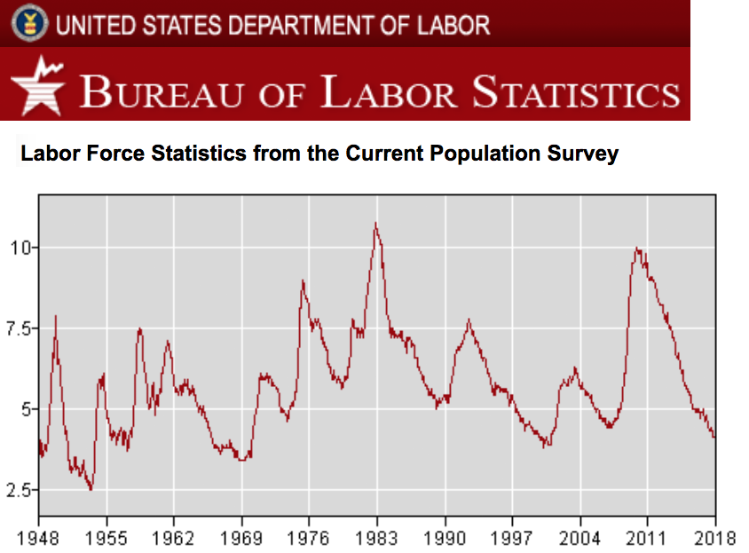
What is Happening to Jobs?

Slide 18
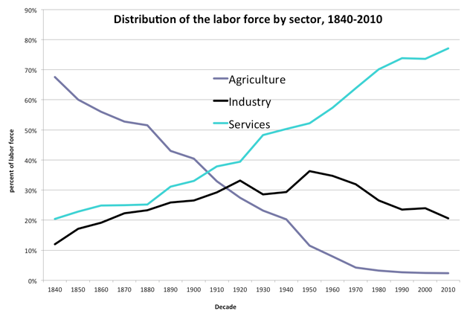
What is Happening to Jobs?
1840–1900: Robert E. Gallman and Thomas J. Weiss. "The Service Industries in the Nineteenth Century." In Production and Productivity in the Service Industries, ed. Victor R. Fuchs, 287-352. New York: Columbia University Press (for NBER), 1969.
1900–1940: John W. Kendrick, Productivity Trends in the United States. Princeton: Princeton University Press (for NBER), 1961.
1950–2010: Bureau of Economic Analysis, National Income and Product Accounts.

Slide 19
What is Happening to Jobs?
Speculation: Oxford University study estimates 47% of current jobs will be automated in the next 20 years
http://www.hrabaconsulting.com/2014/04/03/the-coming-2nd-machine-age-that-obliterates-47-of-all-jobs/

Slide 20
Which Skills are Likely to be Automated?
for COMPUTERS
for HUMANS
Repetitive
Boring/Mindless
Dangerous
Physically Taxing
Consistent Expectations
Problem-Solving
Care-Giving
Nuanced/Creative
Continual Learning
Changing Expectations
Notes:
(Move FAST through these!)

Slide 21
Software Development
Your Kids Should Learn Skills that
will Remain In-Demand
My recommendation:
Notes:
Either as a CAREER
or
as a LIFE SKILL

Slide 22
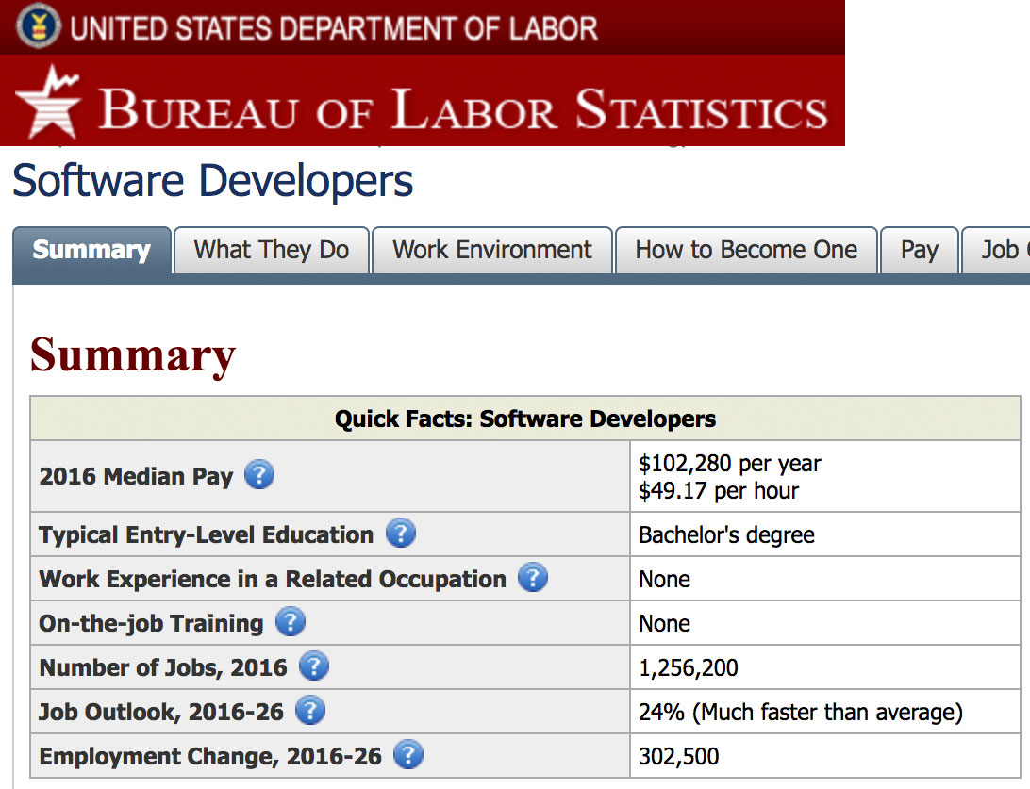
Software Development as a Career
Notes:
Expected Software Developer Job Growth: 24%

Slide 23
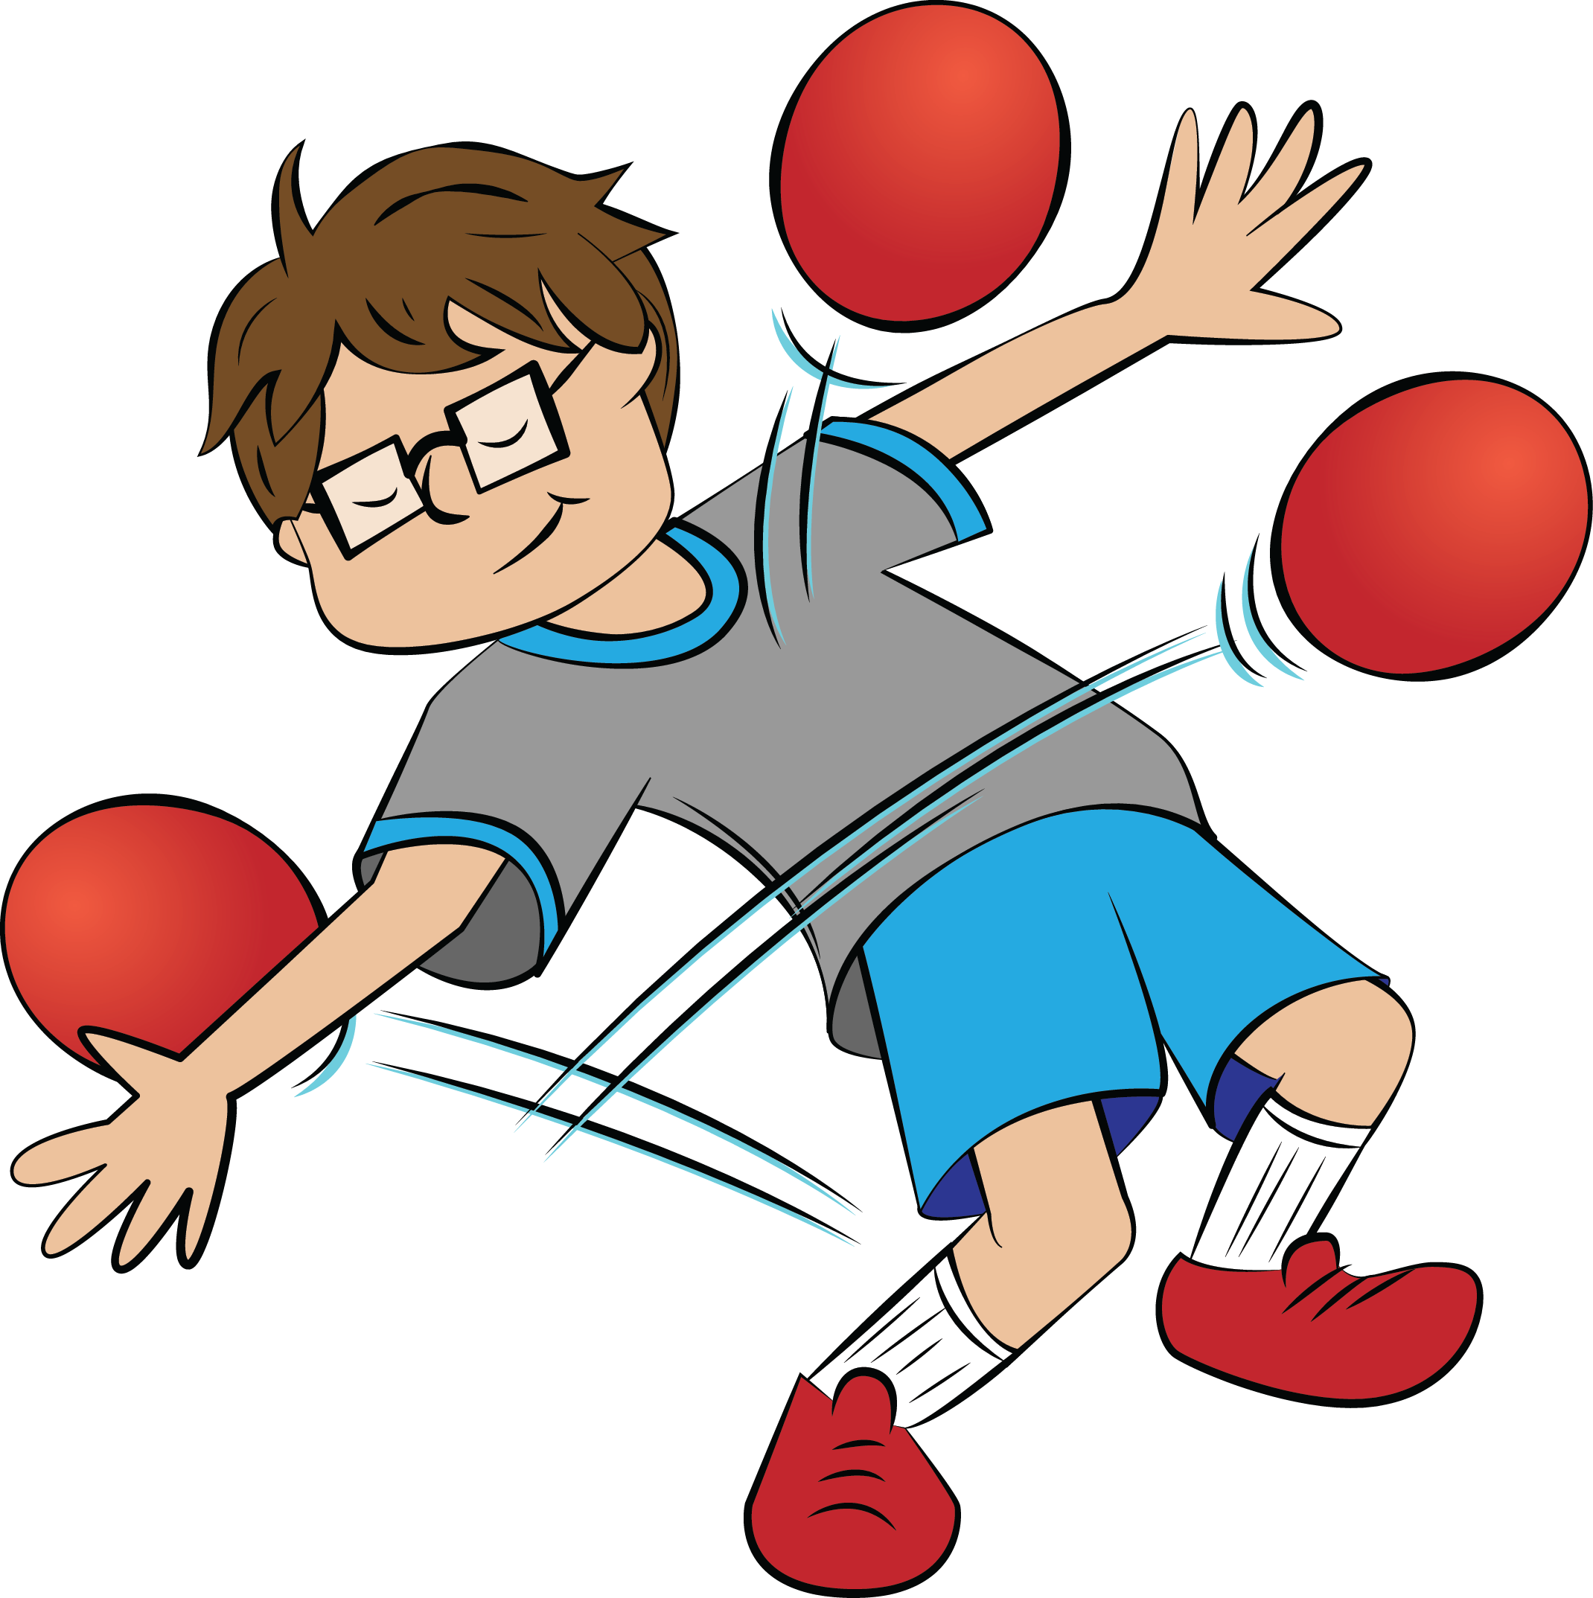
Software Development as a Life Skill
Problem Solving
Abstract Thinking
Communication
Self-Study
Notes:
Teaching writing isn’t necessarily to make everyone a professional writer

Slide 24
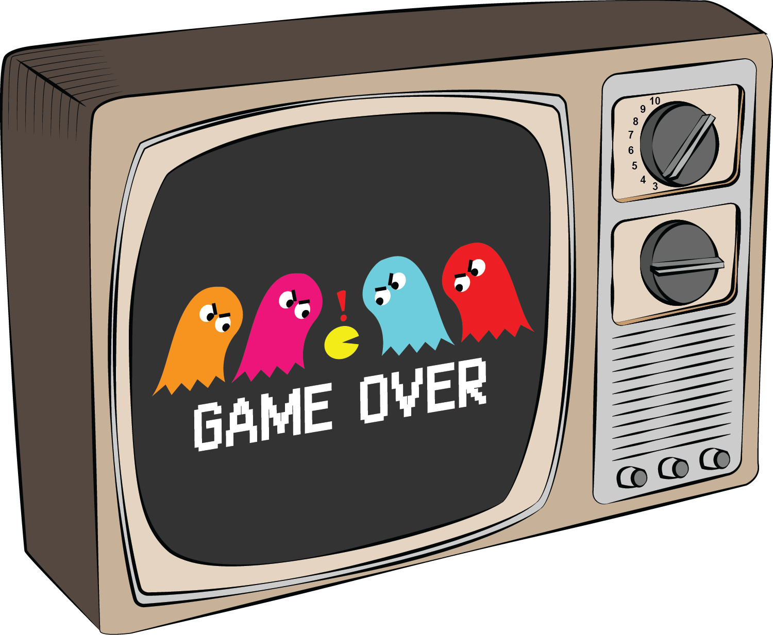

How Do Your Kids Interact with Technology?
Consumption
Creation

Slide 25

Software Development as a Life Skill
Problem Solving
Abstract Thinking
Communication
Self-Study
Creation (not Consumption)
Continual Growth

Slide 26
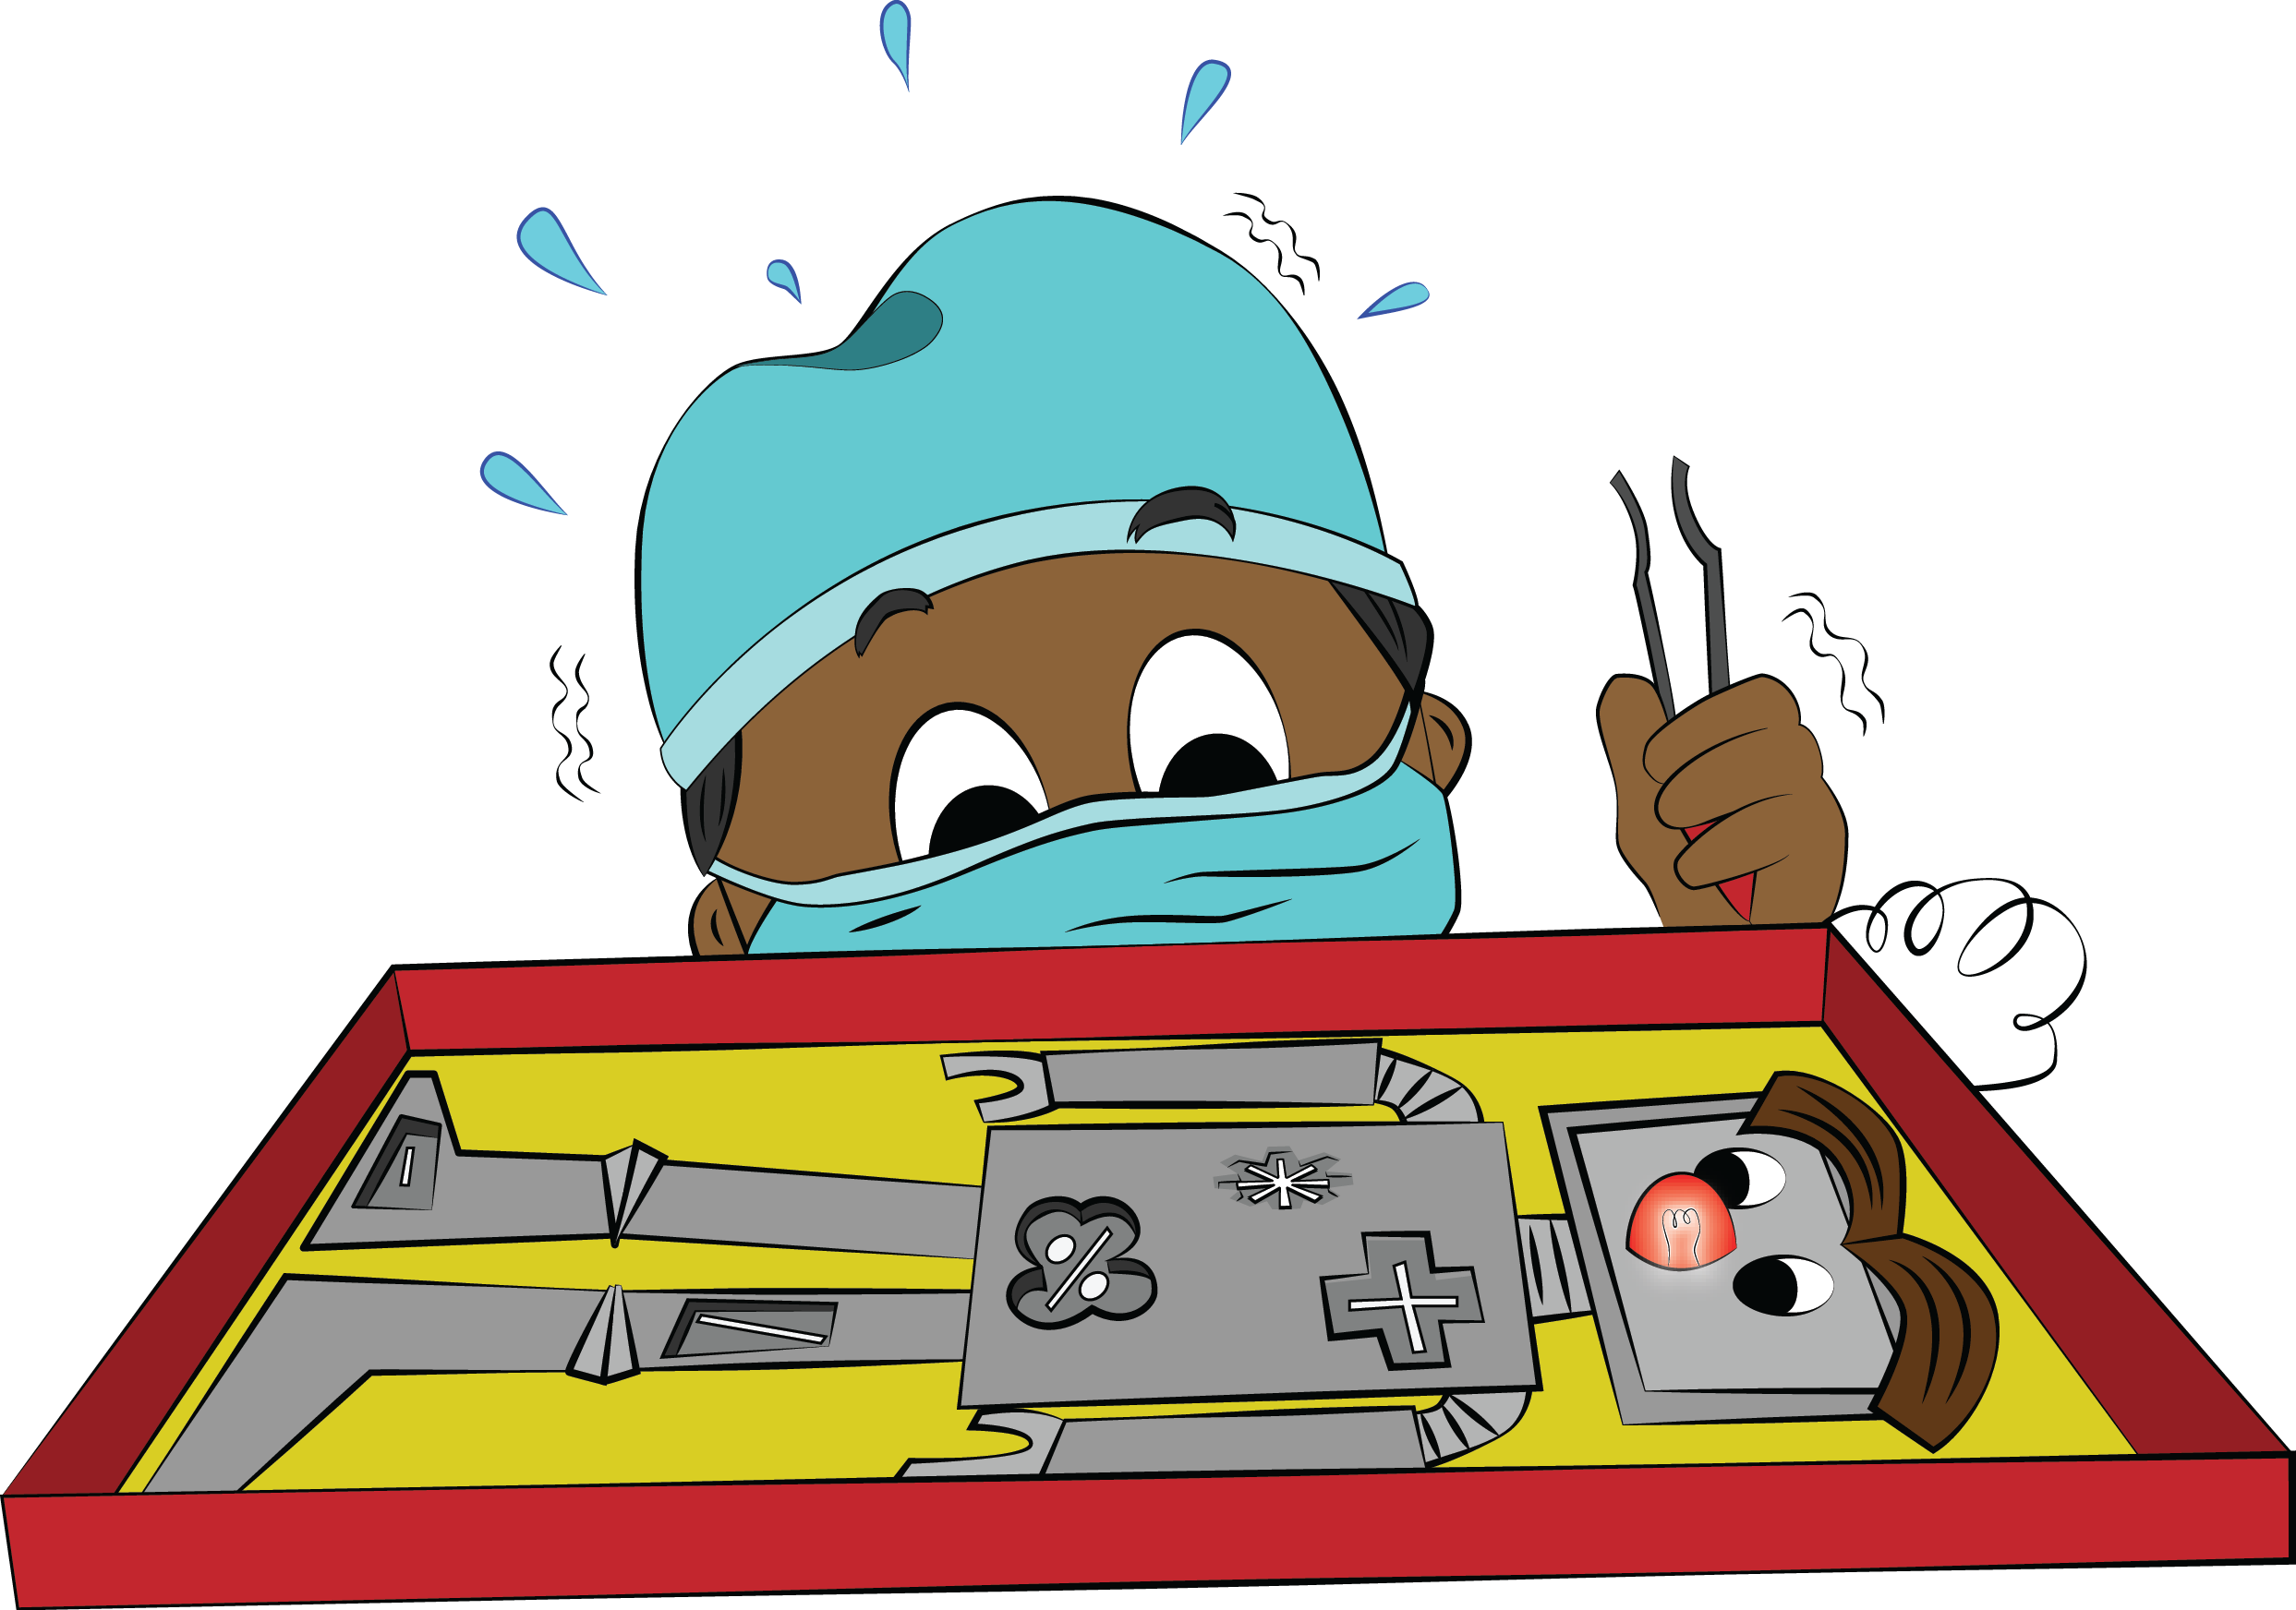
Where to Start?
Notes:
Coding:, you can start small.
Learn a simple skill and then grow from there.

Slide 27
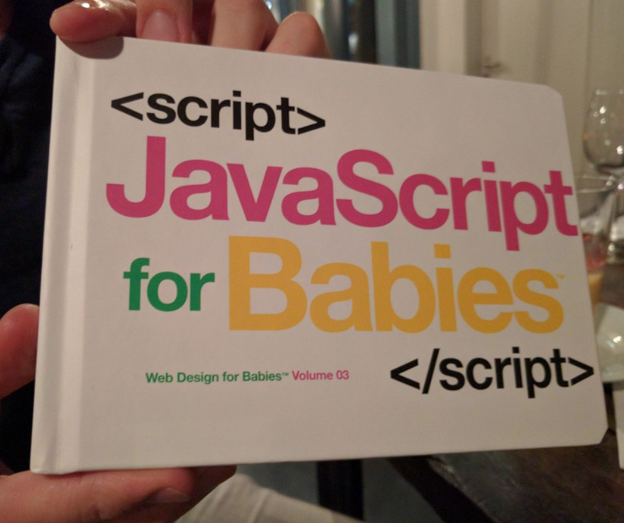
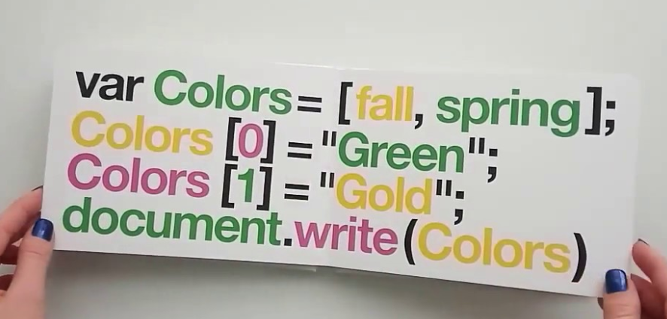
Kids Learn to Code at Any Age

Slide 28
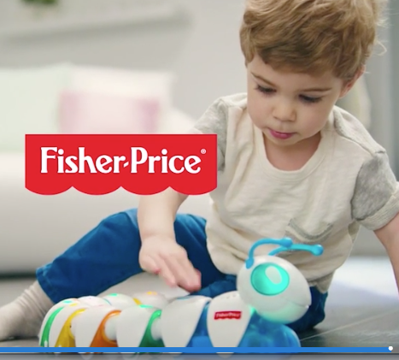
Kids Learn to Code at Any Age
3-6 years old:
Code-a-Pillar
(No need to start this young though!)

Slide 29
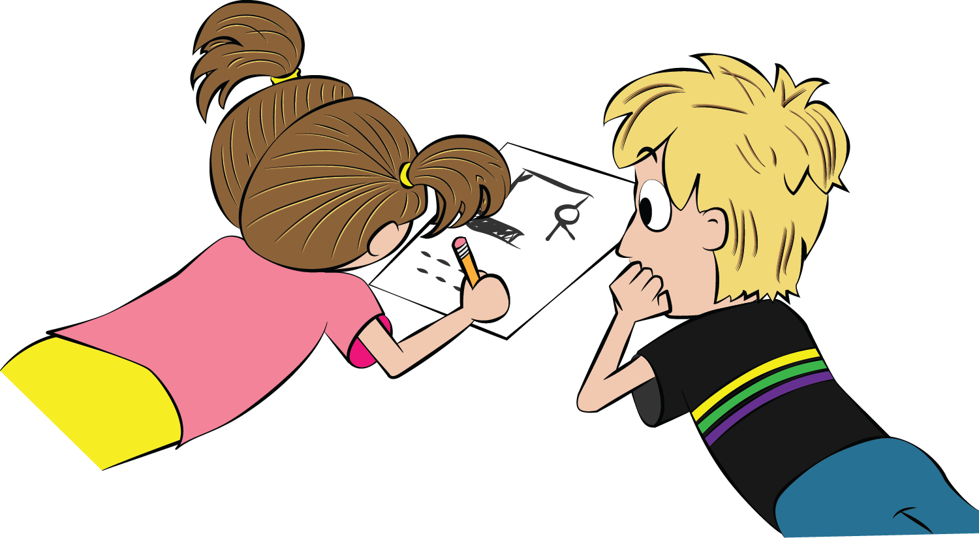
Learning Goals (3-6yo)
Have Fun with Coding
Create Stuff
No Pressure

Slide 30
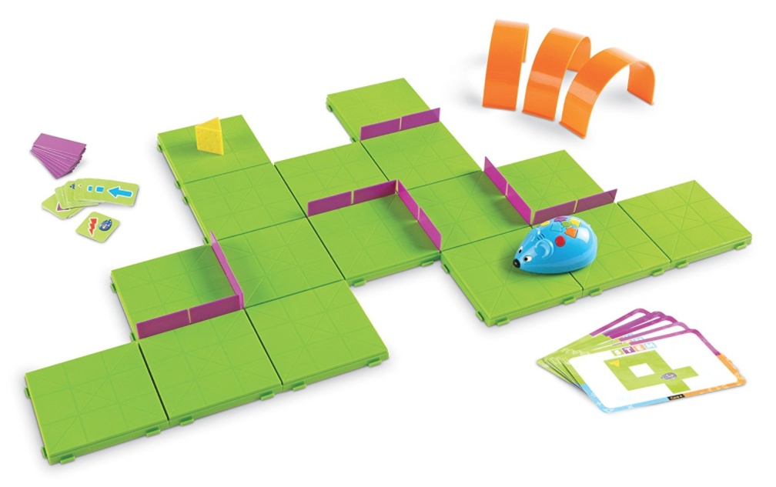
Kids Learn to Code at Any Age
5-8 years old:
Minecraft
Robot Turtles
Code Mouse

Slide 31
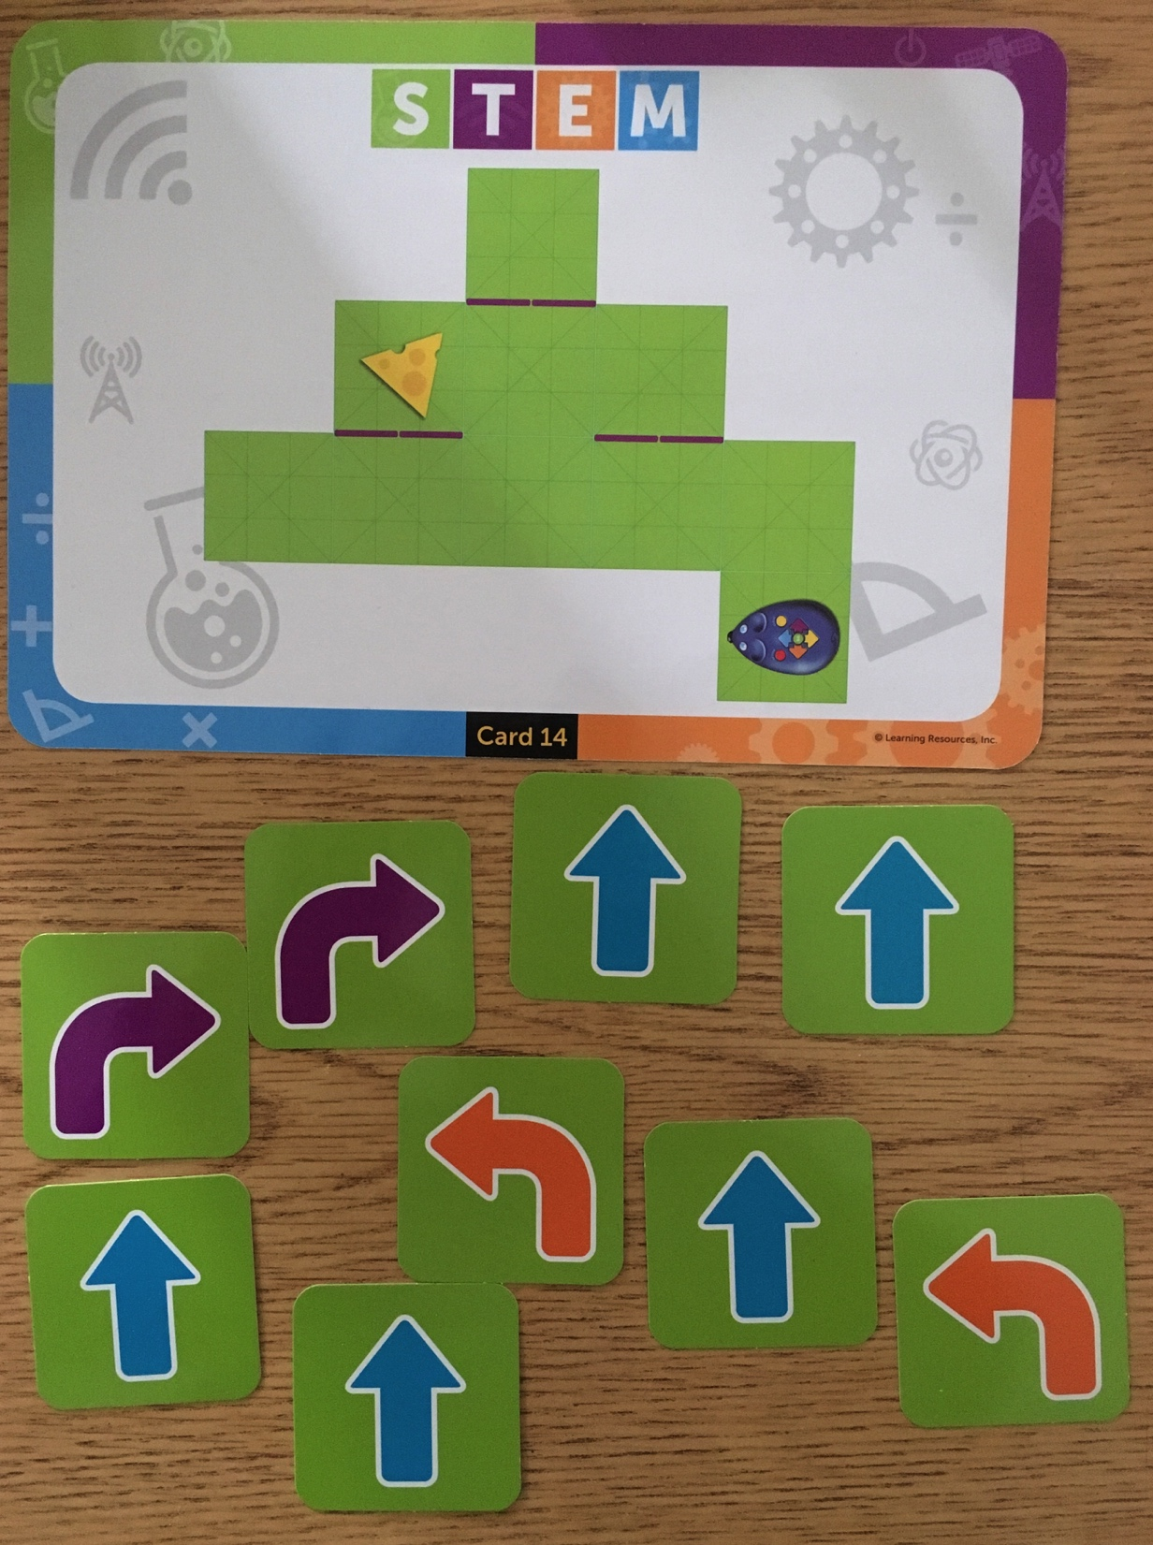

Slide 32
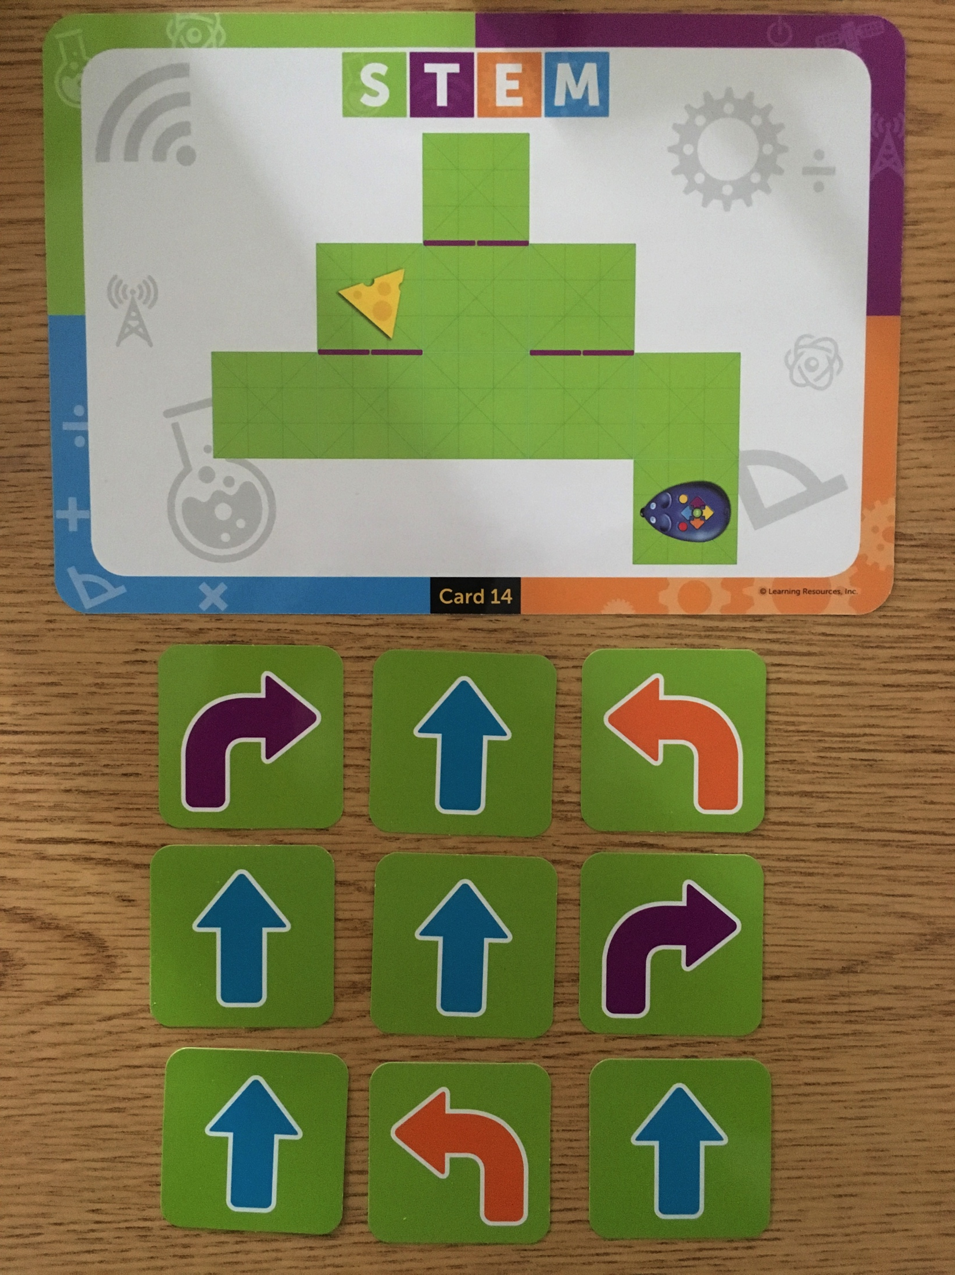

Slide 33

Learning Goals (5-8yo)
Small Problem Solving
Goal-Oriented Creation
Minimal Performance Pressure

Slide 34
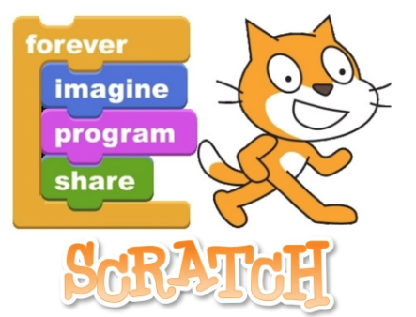
Kids Learn to Code at Any Age
8-12 years old:
Tynker
Scratch

Slide 35
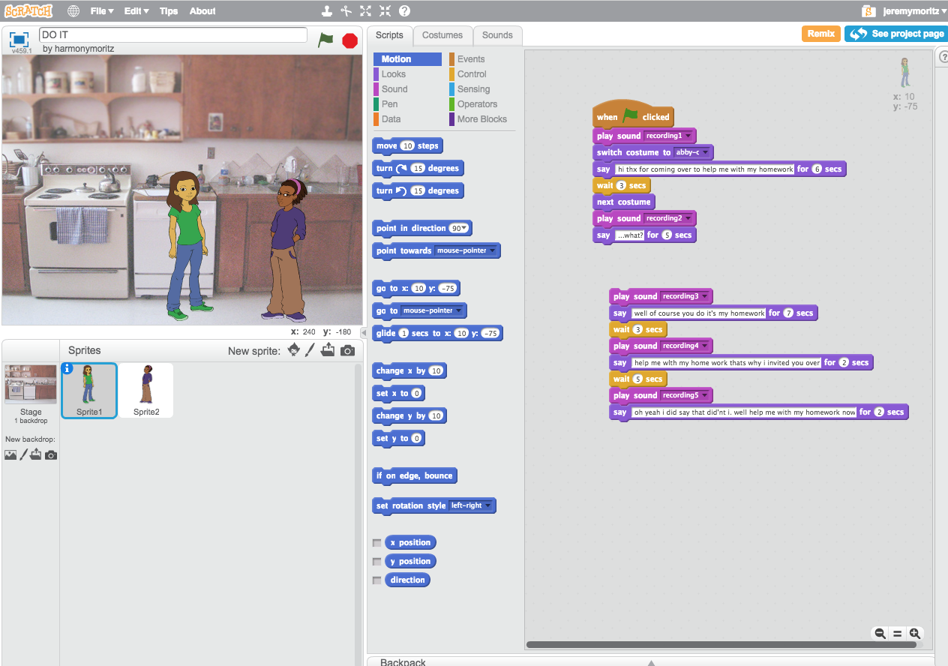
Notes:
https://scratch.mit.edu/projects/170570420
(HarmonyMoritz project: “DO IT”)

Slide 36
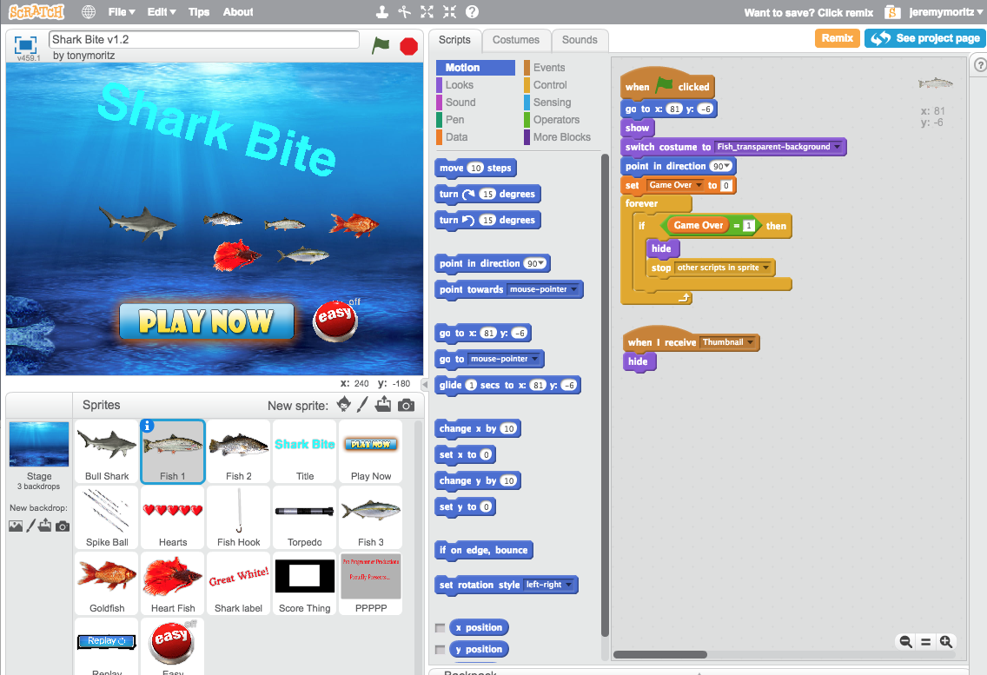
8-12 years old:
Scratch
Tynker
Notes:
https://scratch.mit.edu/projects/197719344/
(tonymoritz project “SHARK BITE”)

Slide 37

Learning Goals (8-12yo)
Moderately Complex Problem Solving
Complete Projects
Begin Without Knowing How to Do It All
Seek Help
Overcome Obstacles
Moderate Performance Pressure

Slide 38
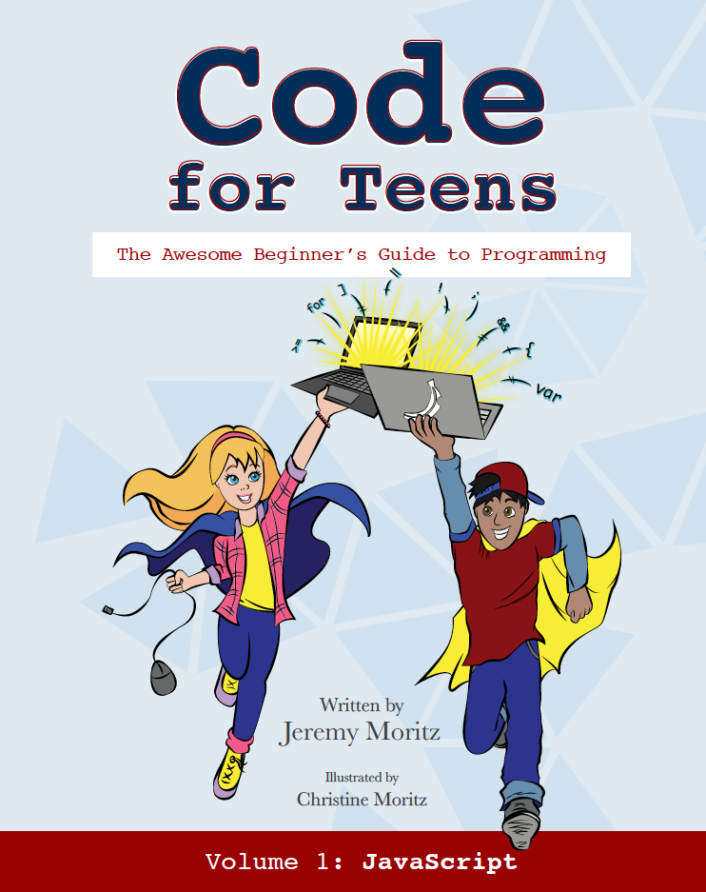
Learn to Code at Any Age
12-16 years old:
TechRocket
Code for Teens book
Notes:
One idea: TechRocket (online platform)
Better idea is CFT (talk to me later if you’d like to hear about this one)

Slide 39

Learning Goals (12-16yo)
Front End (Usually Learn First):
JavaScript
HTML
CSS
Back End (Pick One):
Python, PHP, Ruby, Java, C#
Notes:
Font End: what the user sees (visual)
Back End the processing that the user cannot see - not visual

Slide 40
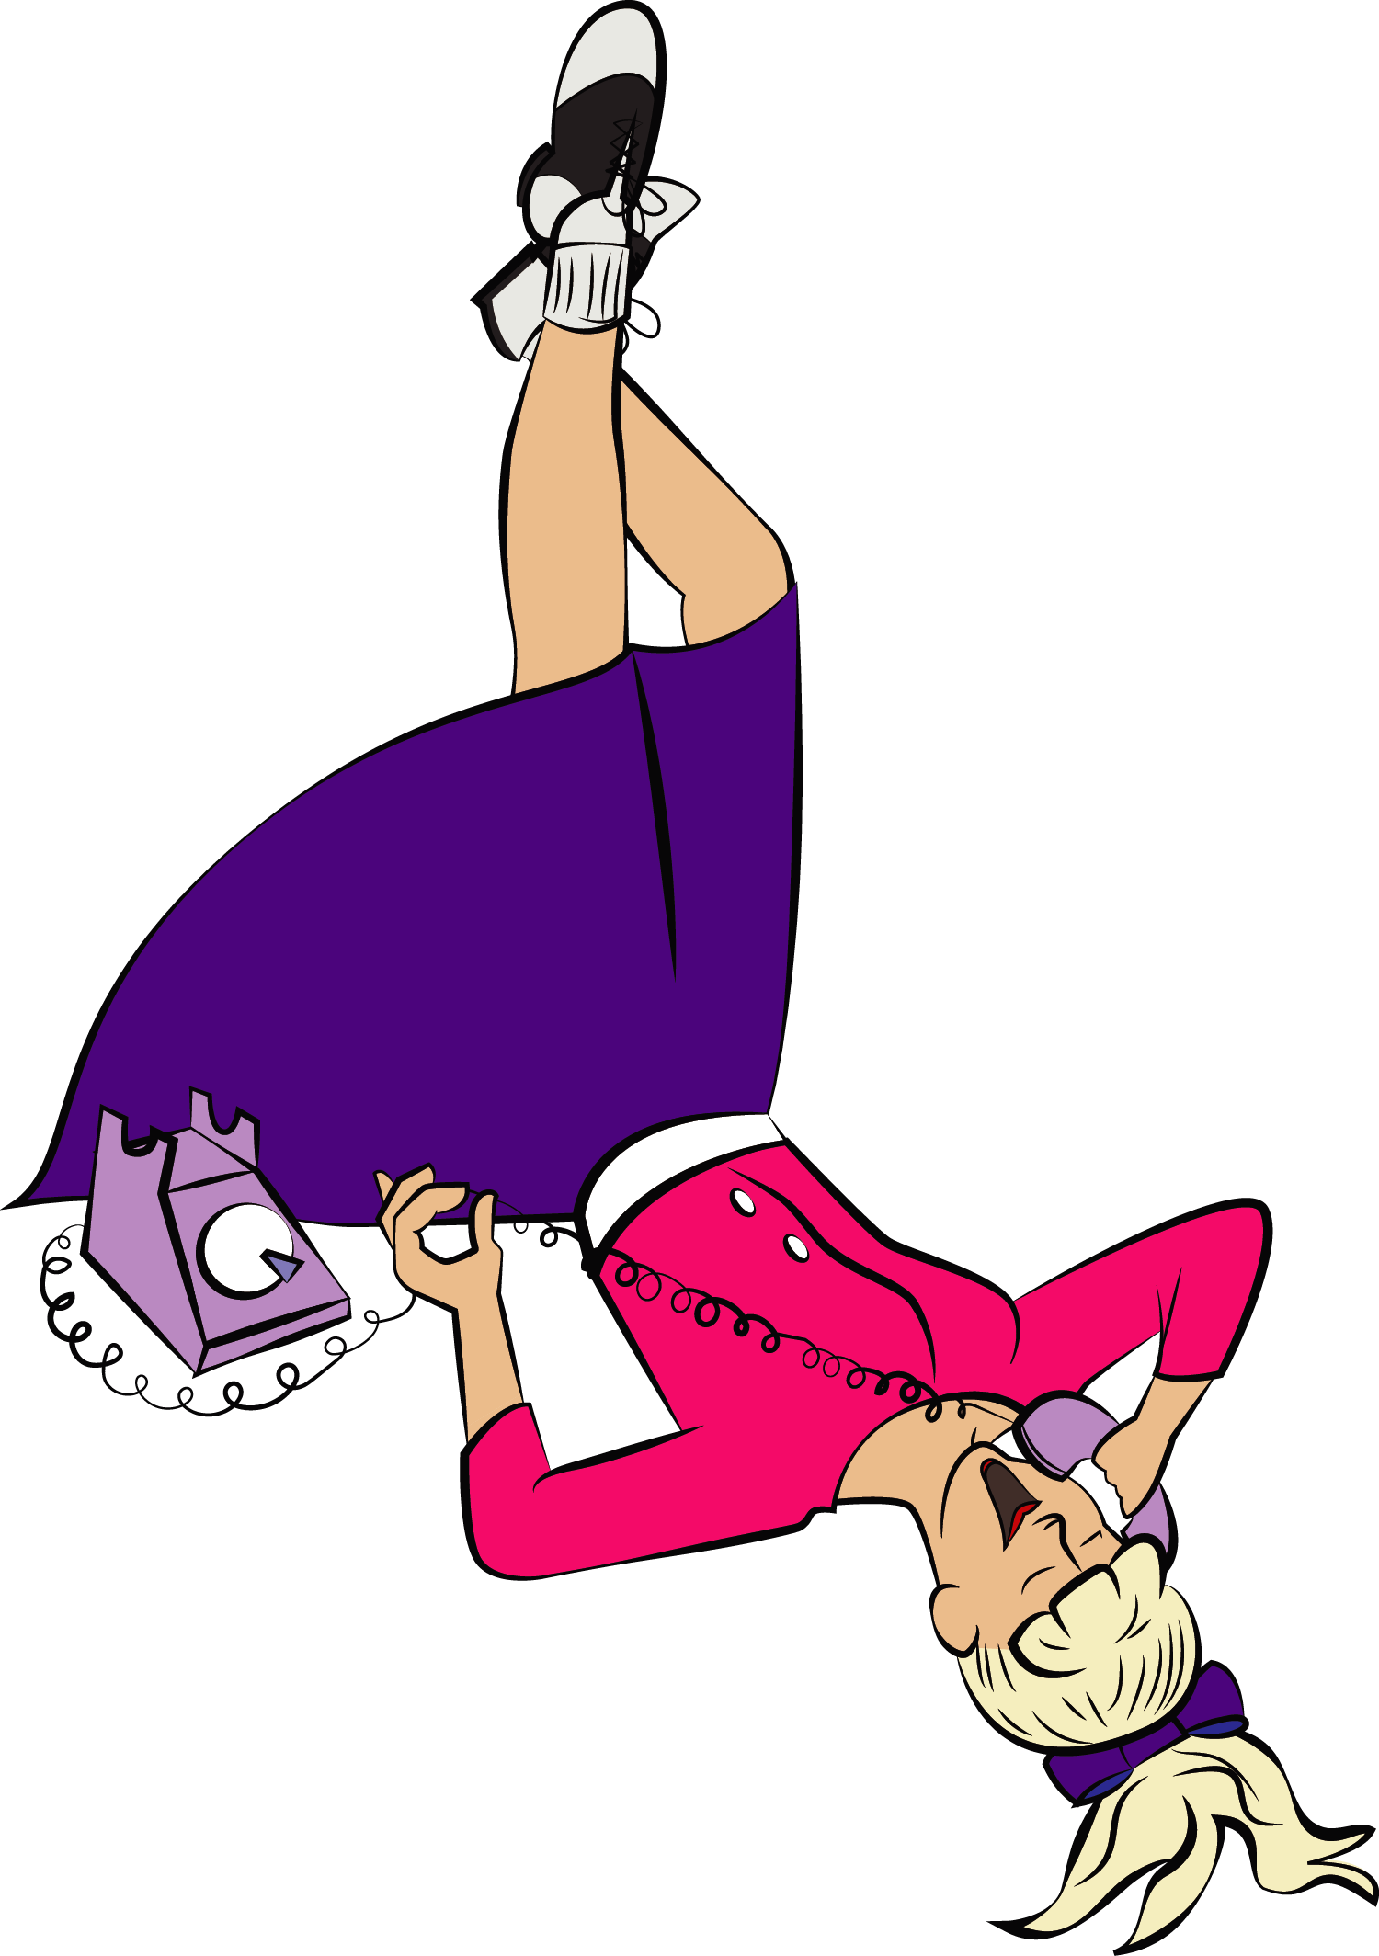
Learn to Code at Any Age
15-18 years old:
Codecademy
Robotics teams
Khan Academy

Slide 41

Learn to Code at Any Age
18+ years old:
Centriq Training
Lynda.com (NOT YouTube)
PluralSight
Meetup Groups

Slide 42
Coding is Fun for Kids!

Slide 43
Trouble with Toys
Notes:
They’re fun
Kids play them for a while and then discard them when they’re no longer fun (Tony story)

Slide 44
Notes:
Tony > Mindstorms

Slide 45
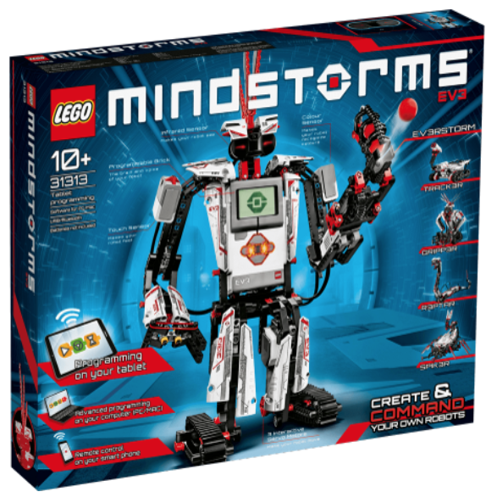
Notes:
“Take this for instance...”
Story of Tony with Expensive Mindstorms Kit

Slide 46
Solution?
Notes:
Let’s get a little exercise:
Stand up if you parents have kids who do math as part of their schooling?
Keep standing if you have at least one kid at home who is GOOD at math.
Keep standing if these same kids ENJOY math.
Keep standing if these same kids purchase books or go online to get additional math problems that they can do just for fun.
So almost NONE of you have kids who are motivated to do math on their own, but almost ALL of you have kids who are doing math anyway as part of their education.
And there’s the key...

Slide 47
Coding = Education (not play)

Slide 48
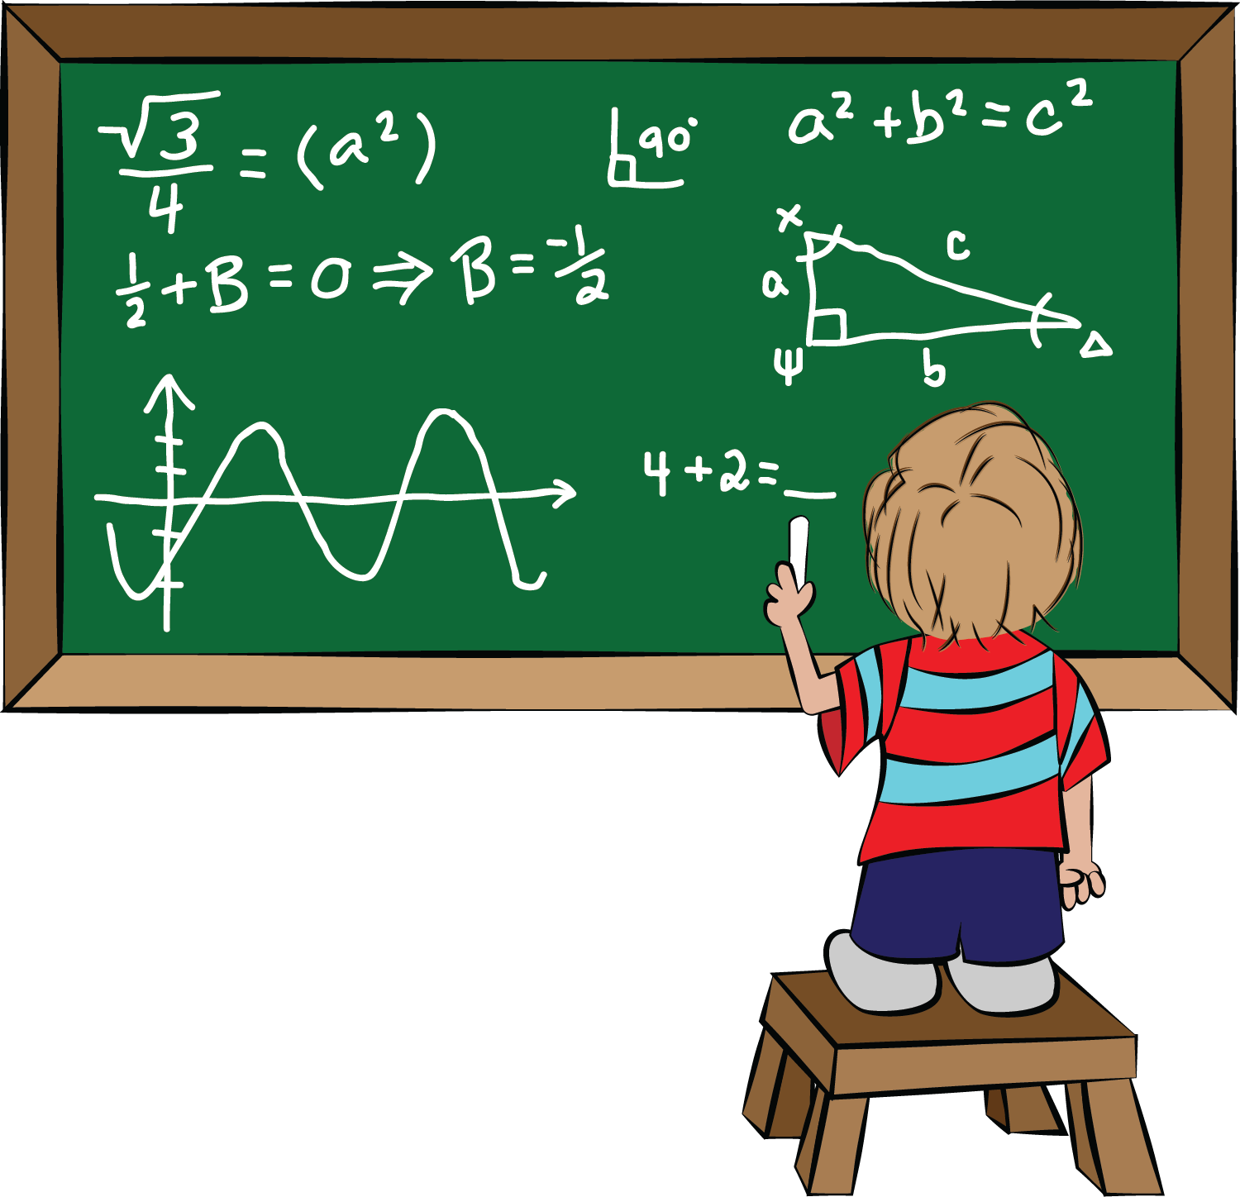
Coding = Education (not play)
Make Requirements
Be flexible
Inspect What You Expect
Monitor the Difficulty
Encourage Repetition.

Slide 49
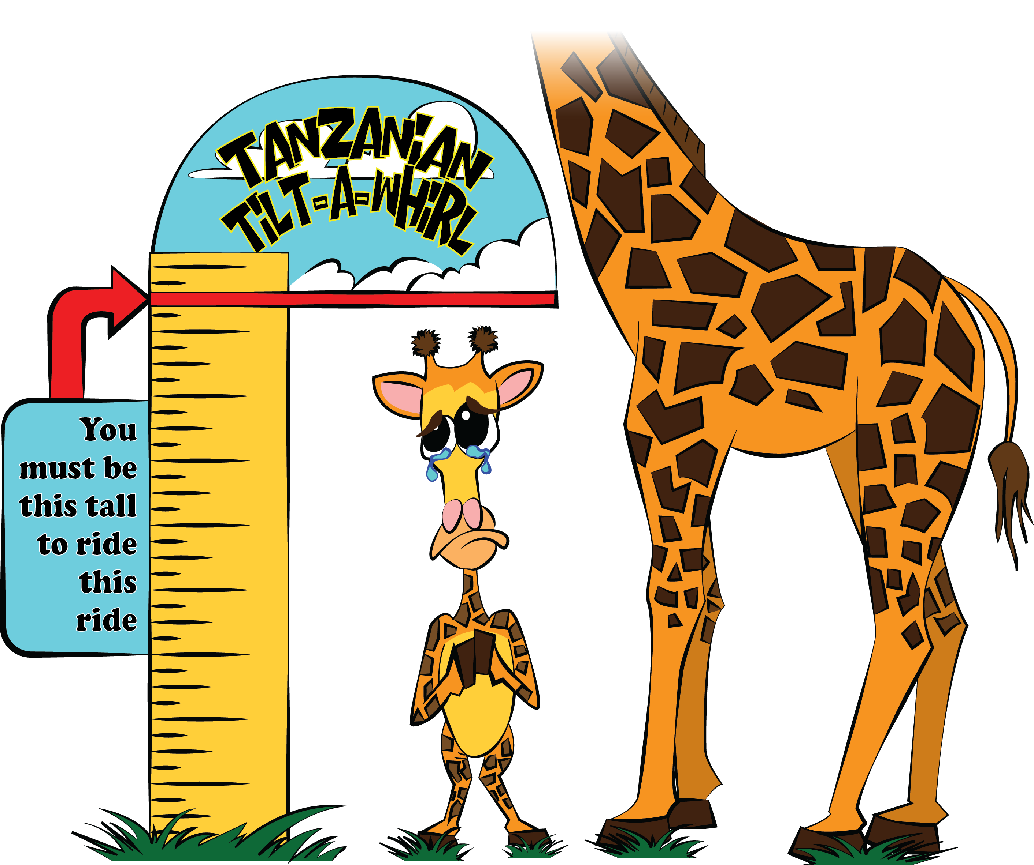
1. Make Requirements
Measurable Expectations to Complete
Chapters?
Assignments?
Page Numbers?
Lessons?
* ~20 minutes per day

Slide 50
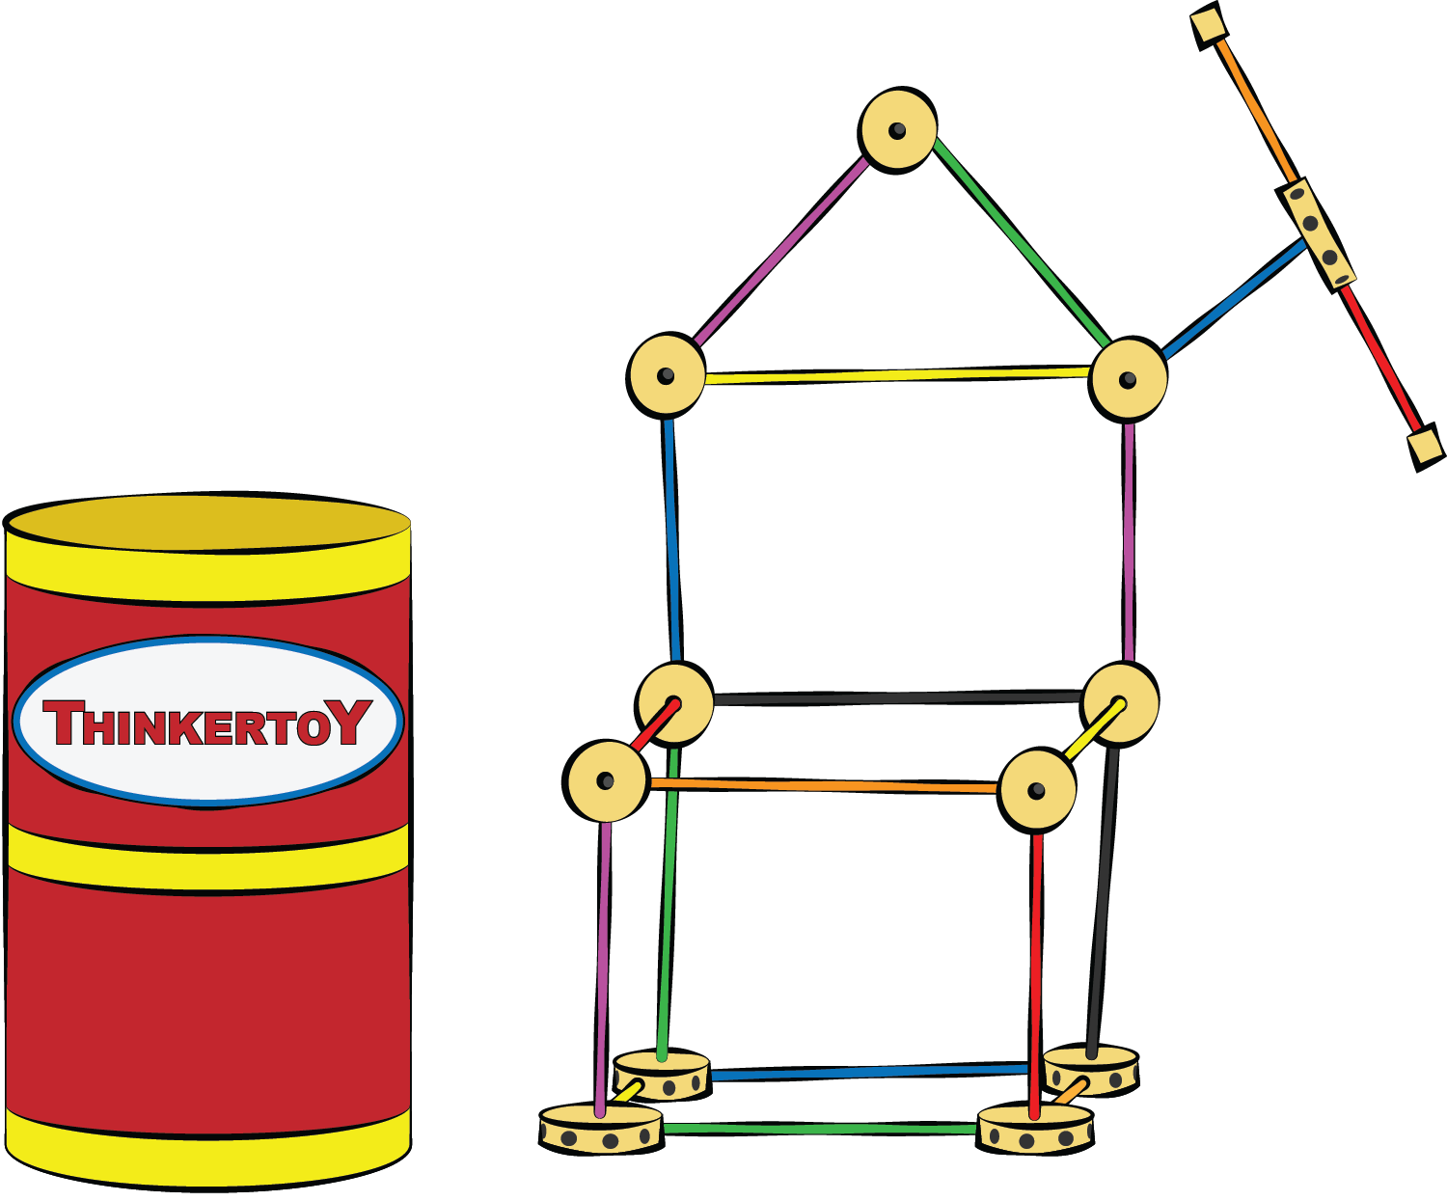
2. Be flexible
Try new curricula--find what works
Allow each to learn at his/her pace
Fail Fast

Slide 51
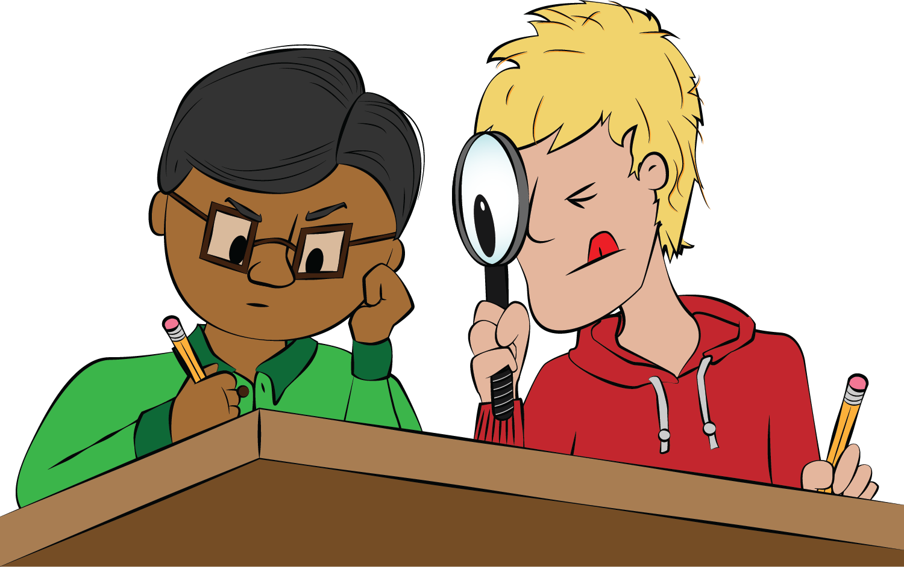
3. Inspect What You Expect
Kids must regularly show their work
You don’t have to understand it
Feign interest
Ask questions
Notes:
Sugata Mitra, professor of educational technology at the University of Newcastle, studies how illiterate Indian Children teach themselves.
calls it “Granny Cloud”: Volunteer “grannies” who ask questions and say encouraging things.
In Sugata’s experience, having a “granny” increases learning by up to 67%!

Slide 52

4. Monitor the Difficulty
Ask what they’ve learned
Monitor difficulty
Too hard?
Appropriately Challenging?
Change methods if needed

Slide 53
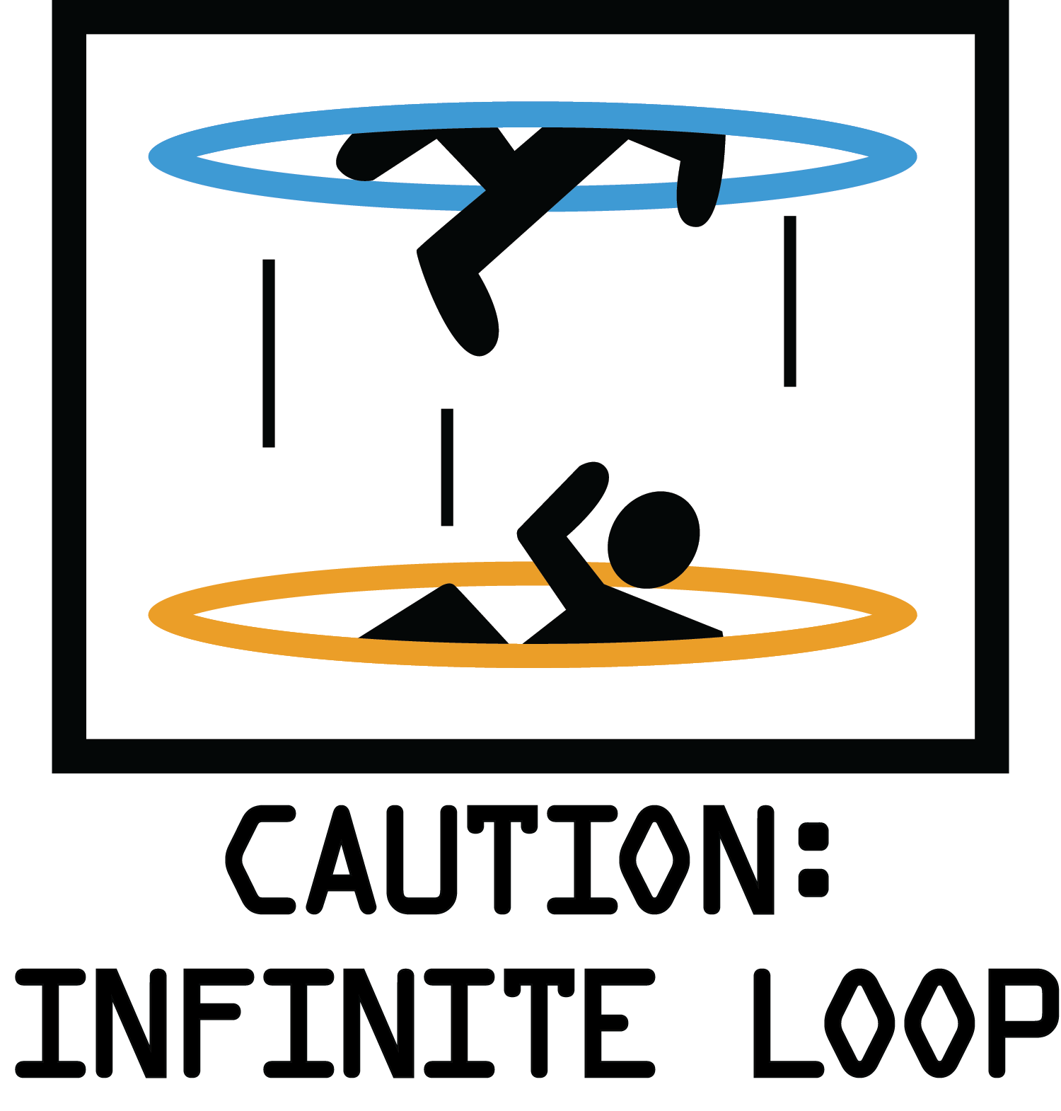
5. Encourage Repetition
Repetition.
Repetition.
Repetition.
Repetition.
Repetition.
Repetition.

Slide 54

5. Repetition
Allow Your Kids to:
Reread Books
Rework Problems
Experiment Freely
Progress at Their Own Pace
If They’re Learning or Solidifying, It Counts!

Slide 55
Coding = Education (not play)
Make Requirements
Be flexible
Inspect What You Expect
Monitor the Difficulty
Encourage Repetition.

Slide 56
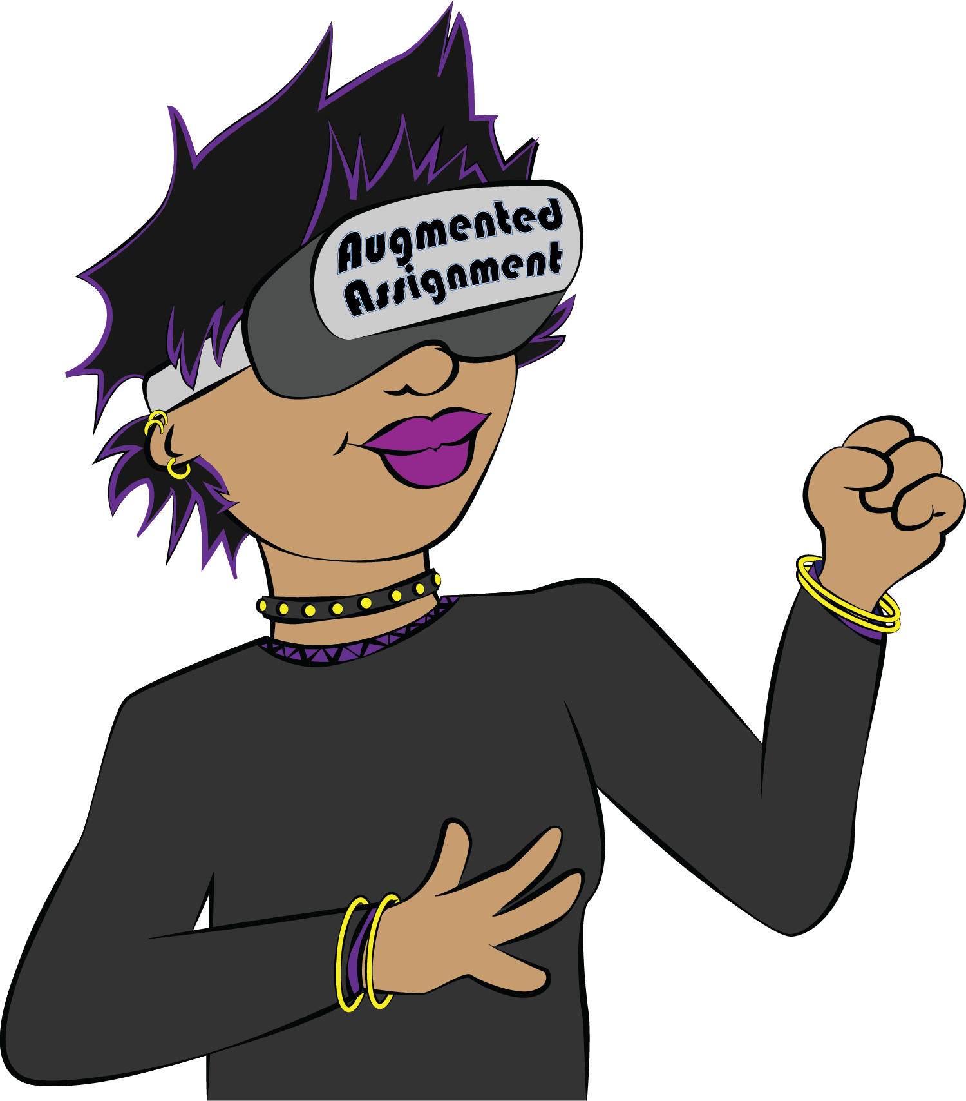
Limit Screen Play Time
CONSUMPTIVE Screen Time
e.g. TV, Game Consoles, Smart Devices
Daily Time Limits
Screens Fast

Slide 57
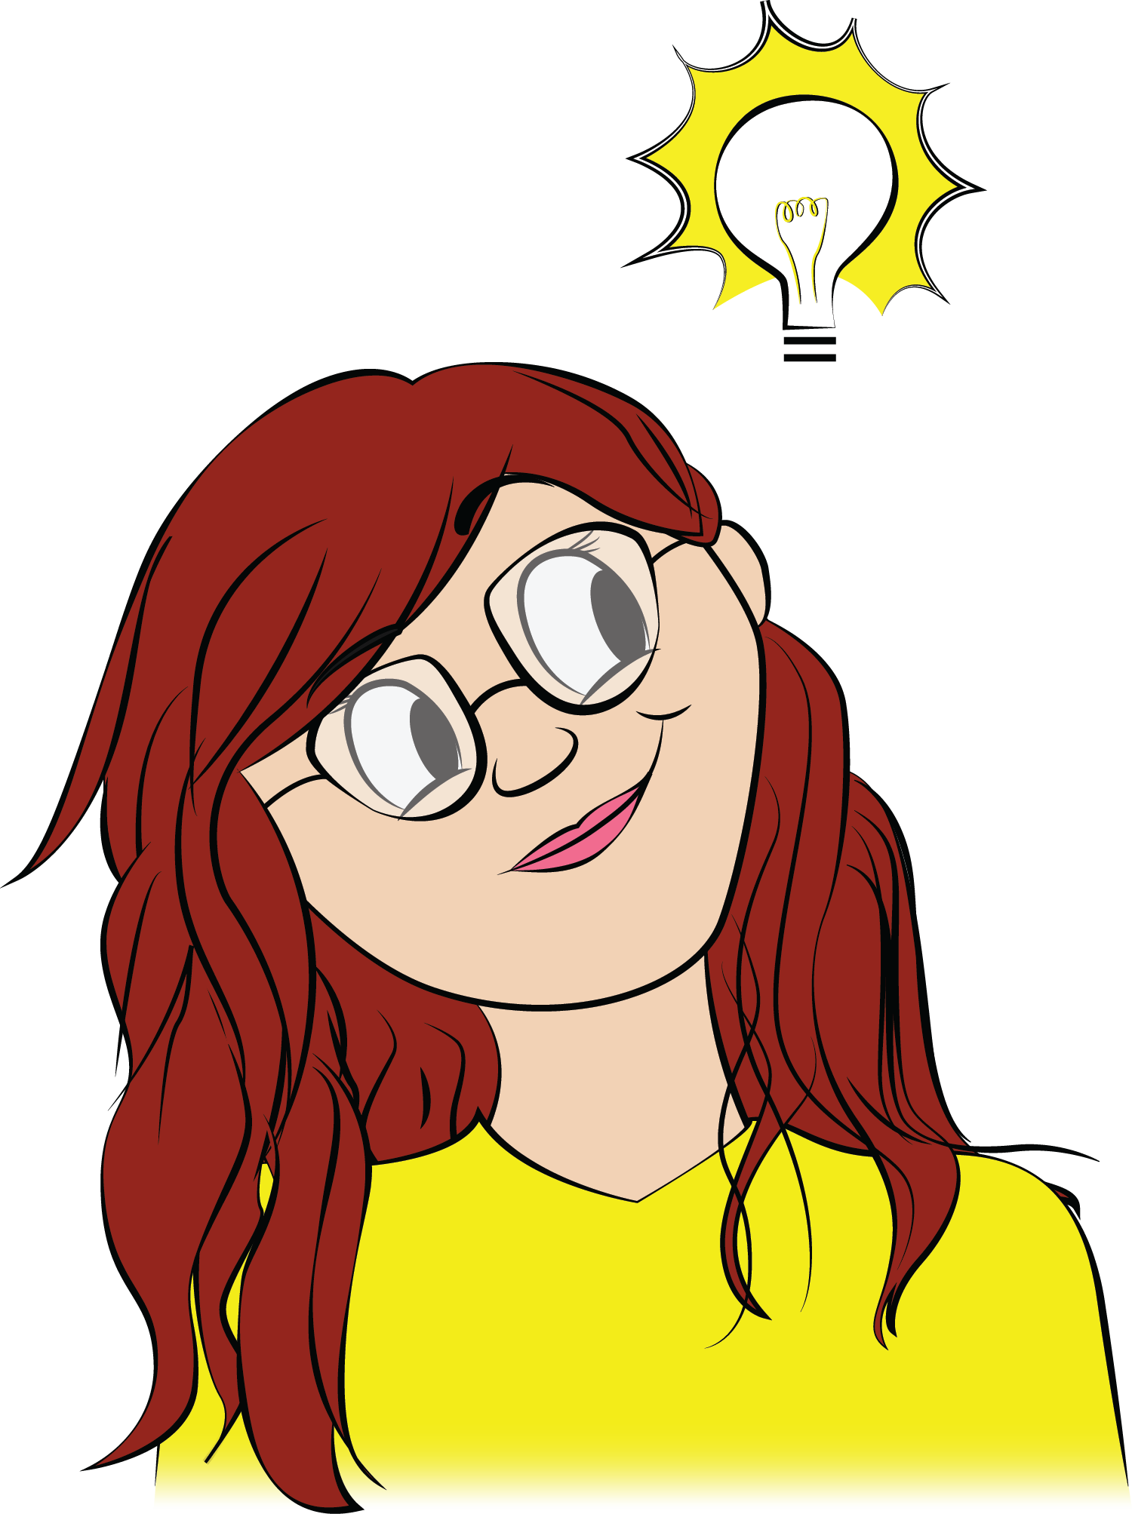
Limit Screen Play Time
PRODUCTIVE Screen Time
e.g. Coding, Writing, Game Creation
More-or-less Unlimited
Watch What Happens...

Slide 58
Notes:
Story about Tony and CoderDojo
Our screens fast is the week before coder dojo
He works that week on his project and presents
1st place two months in a row, then 2nd place the third month

Slide 59
Limit Screen Play Time
CONSUMPTIVE Screen Time
e.g. TV, Game Consoles, Smart Devices
Daily Time Limits
Screens Fast
PRODUCTIVE Screen Time
e.g. Coding, Writing, Game Creation
More-or-less Unlimited
Notes:
Important distinction: CONSUMPTIVE and PRODUCTIVE Screen time
Try this with your own kids and watch what happens!

Slide 60
Questions?
Notes:
Now’s a good time to open it up for questions!
If you wrote down any questions, please raise your hand, as there are probably others with the same question.

Slide 61

Conclusion
Coding is Valuable for Your Kids
As a Career
As a Life Skill
Age-Appropriate Material is Available
Be Intentional with Coding Education
Required Daily Curricula (not playtime)
Replace Another Subject, perhaps?

Slide 62
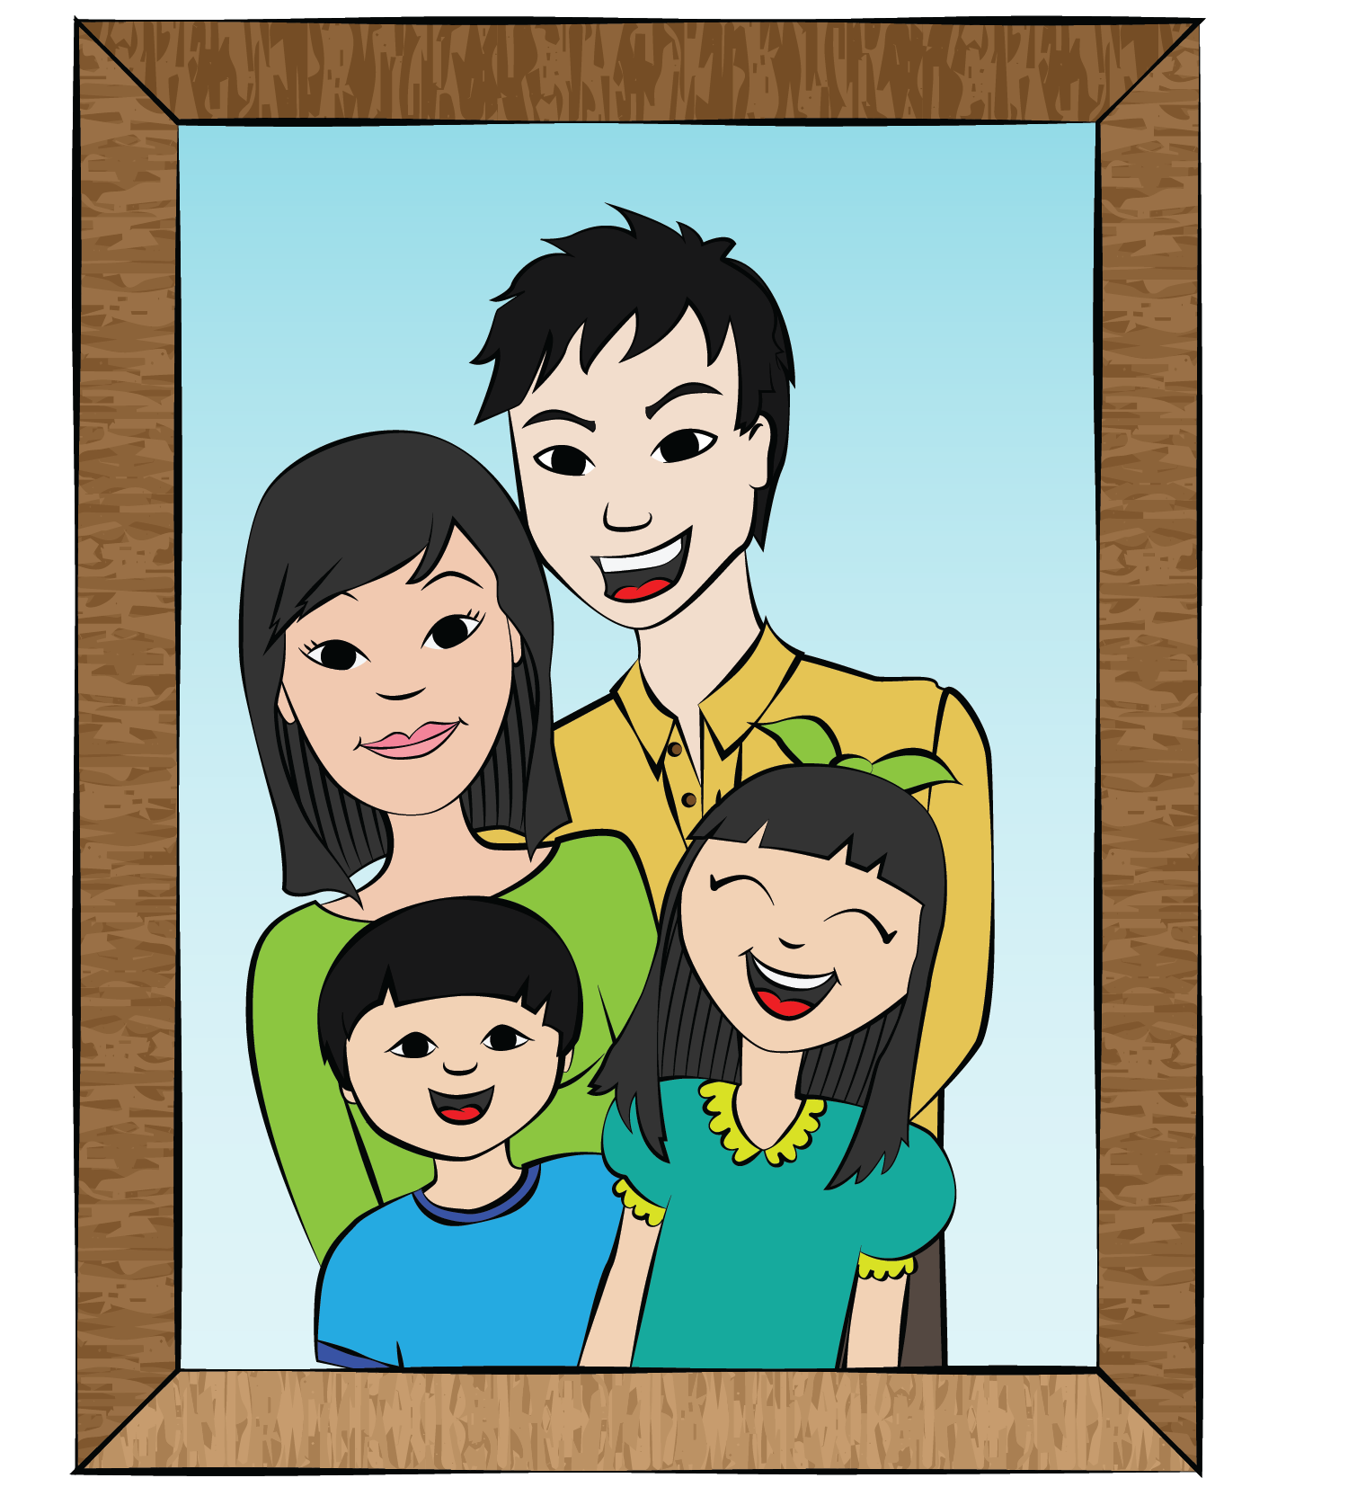
Conclusion
Value of Intentional, Extra-Curricular Education
Take control
Follow your values
Plan for change
Prepare kids for their future
Notes:
Looking at the changing climate and job market
I want you to be forward-looking

Slide 63
Notes:
Prepare your kids for there future
I hope this talk gave you a few useful tools to help you do that.
Thank you for your time, and please come see me if you’d like to hear about the Code for Teens book
Enjoy the rest of your day!

